Slide 1


Ju Yeon Eum
October 2024

Slide 2

Outline
Executive Summary
Introduction
Methodology
Results
Conclusion
Appendix

Slide 3
Executive Summary
Project Overview: This capstone project focuses on predicting the successful landing of SpaceX's Falcon 9 first stage. Accurate prediction can significantly reduce launch costs and improve competition in the aerospace industry.
Summary of Methodologies:
Data Collection: Historical launch data was collected from the SpaceX API and web scraping Wikipedia.
Data Wrangling: The data was cleaned, and missing values were handled to ensure consistency.
Exploratory Data Analysis (EDA): Various visualizations were created to explore relationships between key features such as payload mass, orbit type, and landing success.
Predictive Modeling: Machine learning models (Logistic Regression, SVM, Decision Tree) were trained and fine-tuned using GridSearchCV to find the best parameters for predicting landing success.
Summary of Results:
EDA Results: A clear relationship between payload mass and landing success was identified, with heavier payloads generally correlating to lower success rates. Orbit type also played a significant role, with certain orbits (LEO, ISS) showing higher success rates.
Predictive Model Performance: Logistic Regression emerged as the best-performing model with a test accuracy of 83.33%. Other models, such as SVM and Decision Trees, performed similarly but slightly lower.
Visualization Tools: Folium maps and Plotly Dash were used to create interactive visualizations that helped reveal geographical and operational patterns in the data.

Slide 4
Introduction
Project Background:
SpaceX revolutionized the aerospace industry by significantly reducing launch costs, primarily due to the reuse of the Falcon 9 rocket’s first stage. Understanding the factors that influence whether the first stage successfully lands can help further optimize these launches and offer valuable insights for competitors in the industry.
SpaceX advertises its Falcon 9 rocket launches at approximately $62 million per launch, whereas other providers charge over $165 million. The ability to predict successful landings can greatly reduce operational costs.
Problems to Find Answers:
What factors influence the success of Falcon 9’s first stage landing?
How do variables such as payload mass, launch site, and orbit type affect the likelihood of a successful landing?
Can we build an accurate model to predict landing success, and which machine learning method will provide the best results?

Slide 5

Section 1

Slide 6
Methodology (1/2)
Executive Summary
The methodology summarizes the approach used to collect, process, analyze, and predict SpaceX Falcon 9 landing outcomes. We used various techniques including data wrangling, EDA, interactive analytics, and machine learning for predictive analysis.
Data collection methodology:
Data was collected from two main sources:
SpaceX API: Real-time launch data for Falcon 9 was retrieved.
Web Scraping: Historical launch data was scraped from Wikipedia using BeautifulSoup.
Perform data wrangling:
Data was cleaned and transformed. Missing values were handled, and the data was filtered to retain only Falcon 9 launches. Key information like payload mass, orbit types, and launch site data were included.
Describe how data was processed:
The collected data was standardized and converted into a Pandas DataFrame. Categorical variables were converted into numerical format using techniques like OneHotEncoding, and missing payload values were filled using the mean.

Slide 7
Methodology (2/2)
Perform exploratory data analysis (EDA) using visualization and SQL:
SQL queries were executed to gain insights such as the total number of successful launches per site, and various visualizations like histograms and scatter plots were used to examine relationships between flight numbers, payload mass, and launch outcomes.
Perform interactive visual analytics using Folium and Plotly Dash:
Folium: Used to visualize the geographic location of SpaceX launch sites. Success and failure markers were plotted for each launch site.
Plotly Dash: Created an interactive dashboard that allows filtering of launch data by site and payload mass to analyze success rates dynamically.
Perform predictive analysis using classification models:
Supervised learning techniques were applied to predict the success of Falcon 9 landings. Logistic Regression, Support Vector Machines, Decision Trees, and K-Nearest Neighbors were employed, with the performance of each model assessed through accuracy scores.
How to build, tune, evaluate classification models:
Models were built and tuned using GridSearchCV to find the best hyperparameters. Each model was evaluated using accuracy metrics and confusion matrices to compare their performance on the test dataset.

Slide 8
Data Collection
How data sets were collected.
SpaceX API: We retrieved real-time data from the SpaceX API, including information such as the rocket, launchpad, payload mass, and core details. The API provided extensive data on Falcon 9 launches, which we used for building our predictive models.
Web Scraping: Historical data was gathered using BeautifulSoup to scrape tables from Wikipedia. This included details of previous Falcon 9 and Falcon Heavy launches, which supplemented the real-time API data for more comprehensive analysis.
Data Collection Process:
The data collection process involved:
API Requests: Making GET requests to the SpaceX API for extracting data.
Data Parsing: Extracting relevant information such as rocket type, payload mass, launch site, and landing outcomes.
Web Scraping: Using BeautifulSoup to extract launch data tables from the Wikipedia page for historical launches.
Data Integration: Combining data from the SpaceX API and Wikipedia into a unified dataset for further analysis.

Slide 9
Data Collection – SpaceX API
Identify API Endpoint: Use the SpaceX API to request past launch data from the endpoint https://api.spacexdata.com/v4/launches/past.
Make API Request: Use the Python requests library to send a GET request to retrieve the historical data.
Parse JSON Response: Convert the response from JSON format into a pandas DataFrame using json_normalize.
Extract Key Data: Identify and extract relevant columns such as rocket, payload, launchpad, and cores to get booster version, payload mass, orbit type, and landing outcomes.
Handle Missing Data: Clean the data by filling missing values, particularly for fields like Payload Mass.
Filter Falcon 9 Data: Filter the data to only include Falcon 9 launches.
Save Processed Data: Store the cleaned and filtered data in a CSV file for further analysis.
GitHub URL of SpaceX API calls - notebook
GitHub URL of SpaceX API calls – HTML
Start
API Request
Parse JSON Response
No
Extract Key Data
Clean Missing Data
Yes
Filter Falcon 9 Data
Save Data
End
The interactive function may not display properly on GitHub, so an HTML file also has been provided

Slide 10
Data Collection - Scraping
HTTP Request: Send GET request to Wikipedia using the requests library.
Parse HTML: Use BeautifulSoup to parse the page’s HTML content.
Locate Table: Use BeautifulSoup to find the launch table based on HTML structure.
Extract Data: Scrape the table rows to retrieve launch details.
Clean Data: Remove unnecessary rows and handle any missing or malformed data.
Save Data: Convert the cleaned table into a Pandas DataFrame and export it to CSV.
GitHub URL of the web scraping – notebook
GitHub URL of the web scraping – HTML
Start
HTTP Request to Wikipedia Page
Parse HTML Content
Locate Target Table
Yes
Extract Table Data
Clean Data
No
Save
Data to DataFrame
Save to CSV File
End
The interactive function may not display properly on GitHub, so an HTML file also has been provided

Slide 11
Data Wrangling
Inspect Data : Load the dataset and check for inconsistencies.
Handle Missing Values : Identify columns with missing values (e.g., Payload Mass).
Filter Relevant Data : Filter rows to include only Falcon 9 launches.
Remove Unnecessary Columns : Drop columns that are not relevant (e.g., Flight Number, if not needed).
Feature Engineering : Create new features or labels, e.g., convert landing outcome into binary class (1 for success, 0 for failure).
Save Cleaned Data : Save the cleaned and processed data for further analysis.
GitHub URL of completed data wrangling – notebook
GitHub URL of completed data wrangling – HTML
Start
Inspect Data
Handle Missing Values
Filter Relevant Data
Yes
No
Remove Unnecessary Columns
Feature Engineering
Save Cleaned Data
End
The interactive function may not display properly on GitHub, so an HTML file also has been provided

Slide 12
EDA with Data Visualization
Flight Number vs Launch Site (Scatter Plot)
To visualize the relationship between the number of flights and the launch site.
A scatter plot helps observe trends between different launch sites and the frequency of launches. We can also detect if certain sites have a higher success rate with more launches.
Payload Mass vs Launch Site (Scatter Plot)
To analyze if the payload mass influences launch outcomes at different sites.
It helps in understanding if heavier payloads are more successful at specific sites or if certain sites are better suited for heavier launches.
Success Rate by Orbit Type (Bar Chart)
To compare the success rates of different orbit types.
Bar charts are great for comparing categorical variables like orbit type, helping to easily visualize which orbits have the highest success rates.
Flight Number vs Orbit Type (Scatter Plot)
To explore the relationship between flight numbers and orbit types.
This scatter plot helps visualize whether the flight experience (number of flights) affects success based on the type of orbit.
Payload Mass vs Orbit Type (Scatter Plot)
To analyze how payload mass correlates with different orbit types.
This chart helps to examine if certain orbit types can handle heavier payloads more successfully.
Launch Success Yearly Trend (Line Chart)
To track the trend of launch success rates over the years.
Line charts are effective for visualizing trends over time. This chart helps identify if SpaceX has improved its success rate over the years.
GitHub URL of completed EDA with data visualization – notebook
GitHub URL of completed EDA with data visualization – HTML
The interactive function may not display properly on GitHub, so an HTML file also has been provided

Slide 13
EDA with SQL
Unique Launch Sites: To identify the different launch sites used for Falcon 9 launches.
Query: SELECT DISTINCT launch_site FROM spacex_data;
Launch Sites Starting with ‘CCA’: To display records of launch sites beginning with "CCA" for detailed analysis.
Query: SELECT * FROM spacex_data WHERE launch_site LIKE 'CCA%';
Total Payload Mass by NASA (CRS) Missions: To calculate the total payload mass carried by NASA's Commercial Resupply Services (CRS) missions.
Query: SELECT SUM(payload_mass) FROM spacex_data WHERE customer = 'NASA (CRS)';
Average Payload Mass for Booster Version F9 v1.1: To determine the average payload mass for the booster version F9 v1.1.
Query: SELECT AVG(payload_mass) FROM spacex_data WHERE booster_version = 'F9 v1.1';
First Successful Landing Date on Ground Pad: To find the date of the first successful landing on a ground pad.
Query: SELECT MIN(launch_date) FROM spacex_data WHERE landing_outcome = 'Success (ground pad)';
Boosters with Success on Drone Ship and Payload Between 4000-6000 kg: To list boosters with successful landings on drone ships and payloads within a specific mass range.
Query: SELECT booster_version FROM spacex_data WHERE landing_outcome = 'Success (drone ship)' AND payload_mass BETWEEN 4000 AND 6000;
Total Number of Successful and Failed Landings: To tally successful and failed landings across all missions.
Query: SELECT landing_outcome, COUNT(*) FROM spacex_data GROUP BY landing_outcome;
Booster Versions with Maximum Payload Mass: To identify booster versions that carried the heaviest payloads.
Query: SELECT booster_version FROM spacex_data WHERE payload_mass = (SELECT MAX(payload_mass) FROM spacex_data);
Landing Outcomes in 2015 with Failure on Drone Ships: To analyze failed drone ship landings in 2015, along with booster versions and launch sites.
Query: SELECT SUBSTR(launch_date, 6, 2) AS month, booster_version, launch_site FROM spacex_data WHERE SUBSTR(launch_date, 1, 4) = '2015' AND landing_outcome = 'Failure (drone ship)';
Ranked Landing Outcomes Between 2010 and 2017: To rank the count of landing outcomes between 2010 and 2017 in descending order.
Query: SELECT landing_outcome, COUNT(*) FROM spacex_data WHERE launch_date BETWEEN '2010-06-04' AND '2017-03-20' GROUP BY landing_outcome ORDER BY COUNT(*) DESC;
GitHub URL of completed EDA with SQL – notebook
GitHub URL of completed EDA with SQL - HTML
The interactive function may not display properly on GitHub, so an HTML file also has been provided

Slide 14
Build an Interactive Map with Folium
Launch Site Markers & Circles:
Markers: Placed at each SpaceX launch site to show their precise location (CCAFS LC-40, KSC LC-39A, etc.).
Circles: Added around launch sites to highlight their proximity to geographical landmarks such as coastlines, roads, and cities.
Success/Failure Markers:
Markers: Green markers represent successful launches, while red markers show failed ones. These markers help visualize the success rate of launches at each site.
Clustered Markers:
Purpose: To manage the overlapping of multiple markers for the same coordinates, a cluster feature is used. This groups launches from the same site, making the map clearer.
Distance Lines Between Sites and Proximity Points:
Lines: Drawn between launch sites and nearby infrastructure (e.g., coastline, railways, highways, and cities) to analyze how launch site proximity affects operations.
MousePosition Feature:
Purpose: Allows users to identify exact geographical coordinates of various points on the map by moving the cursor, ensuring precision when analyzing site proximity.
These objects were added to visually assess how launch site success correlates with infrastructure proximity, logistical factors, and site-specific outcomes.
GitHub URL of completed interactive map with Folium map – notebook
GitHub URL of completed interactive map with Folium map – HTML
The interactive function may not display properly on GitHub, so an HTML file also has been provided

Slide 15
Build a Dashboard with Plotly Dash
Summary of Dashboard Plots/Graphs and Interactions:
Dropdown for Launch Site Selection:
Why: Allows users to filter data by different launch sites to view specific insights per location, enhancing the interactivity and user control over the analysis.
Pie Chart for Launch Success Rate:
Why: Provides a clear visual representation of the success vs. failure rates for each launch site. This helps users quickly assess the performance of SpaceX at various locations.
Payload Range Slider:
Why: Allows users to explore the relationship between payload mass and launch success. It enables filtering data for specific payload mass ranges and observing how this factor affects the outcome of a launch.
Scatter Plot for Payload Mass and Success Correlation:
Why: Demonstrates the relationship between payload mass and the success of a launch. It helps to identify trends and patterns, such as whether higher payloads correlate with more or less successful landings.
These visualizations and interactions provide an intuitive way for users to explore the data and uncover trends related to SpaceX launches, including the impact of different factors on launch success.
GitHub URL of Plotly Dash - Python

Slide 16
Predictive Analysis (Classification)
Model Development Process
Data Preprocessing:
Standardized features
Split data (80% training, 20% testing)
Model Selection:
Logistic Regression, SVM, Decision Tree, KNN
Hyperparameter Tuning:
Used GridSearchCV (10-fold cross-validation)
Model Evaluation:
Accuracy Score
Confusion Matrix
Model Improvement:
Tuned parameters for the best performance
Best Model Selection:
Selected based on test accuracy and confusion matrix results
GitHub URL of predictive analysis lab – notebook
GitHub URL of predictive analysis lab – HTML
Start
Data Preprocessing
Model Selection
Hyperparameter Tuning
Model Evaluation
Yes
Best Model Selection
End
No
Model Improvement
The interactive function may not display properly on GitHub, so an HTML file also has been provided

Slide 17
Results (1/3)
1. Exploratory Data Analysis Results
Payload Mass Distribution: Visualized to understand how payload mass affects launch success.
Flight Number vs Launch Site: Explored relationships between the number of flights and success rate by site.
Success Rate by Orbit Type: Bar chart showing success rates across different orbits to determine which orbits are most reliable.
Yearly Success Trend: Line chart visualizing the trend of successful launches over the years.

Slide 18
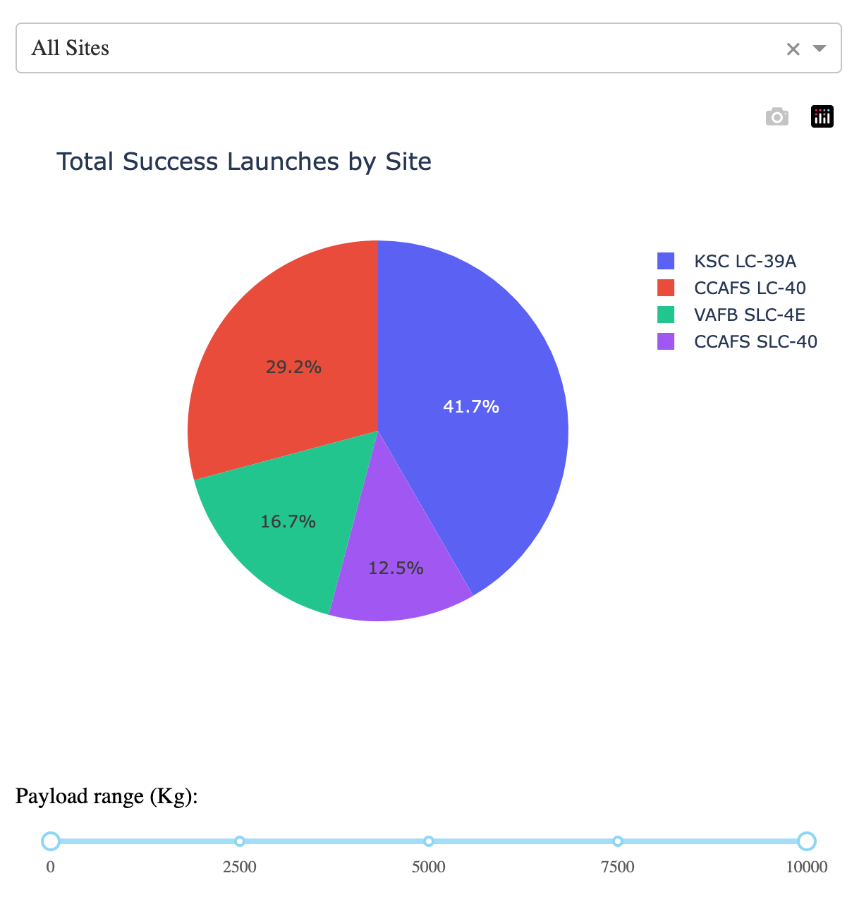
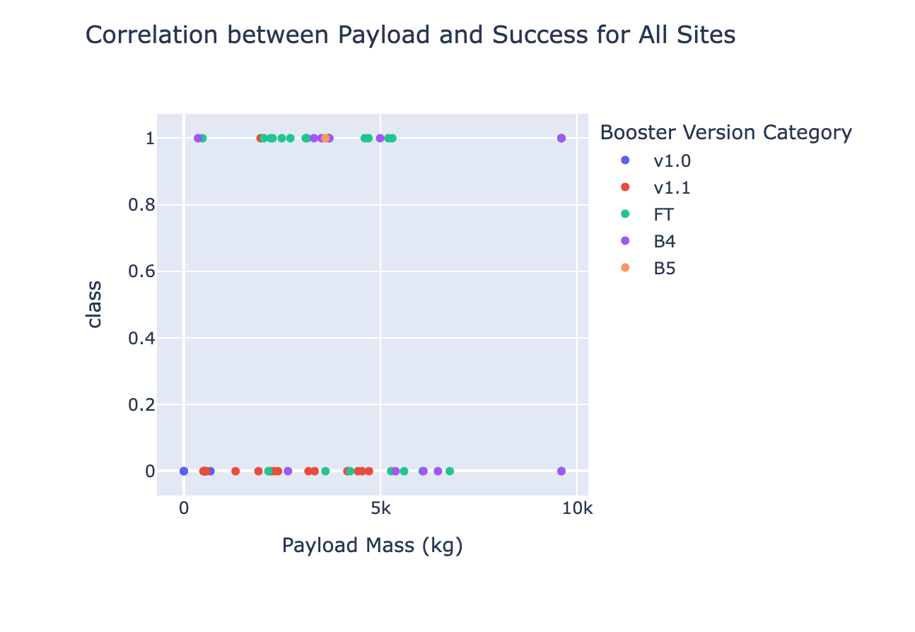
Results (2/3)
2. Interactive Analytics Demo
Folium Map: Added markers for each launch site, color-coded based on success/failure.
Plotly Dash:
Launch Site Dropdown: Allows users to filter data based on launch sites.
Payload Slider: Filters data based on payload mass to see the impact on launch success.
Scatter Plot: Shows correlation between payload mass and success rate, categorized by booster version.

Slide 19
Results (3/3)
3. Predictive Analysis Results
Best Performing Model: Logistic Regression achieved the highest accuracy after hyperparameter tuning, with a test accuracy of 83.33%.
Confusion Matrix: Used to evaluate classification performance, with minimal false positives.
Model Improvement: Hyperparameters were tuned for better accuracy and generalization, ensuring a robust predictive model.

Slide 20

Section 2

Slide 21
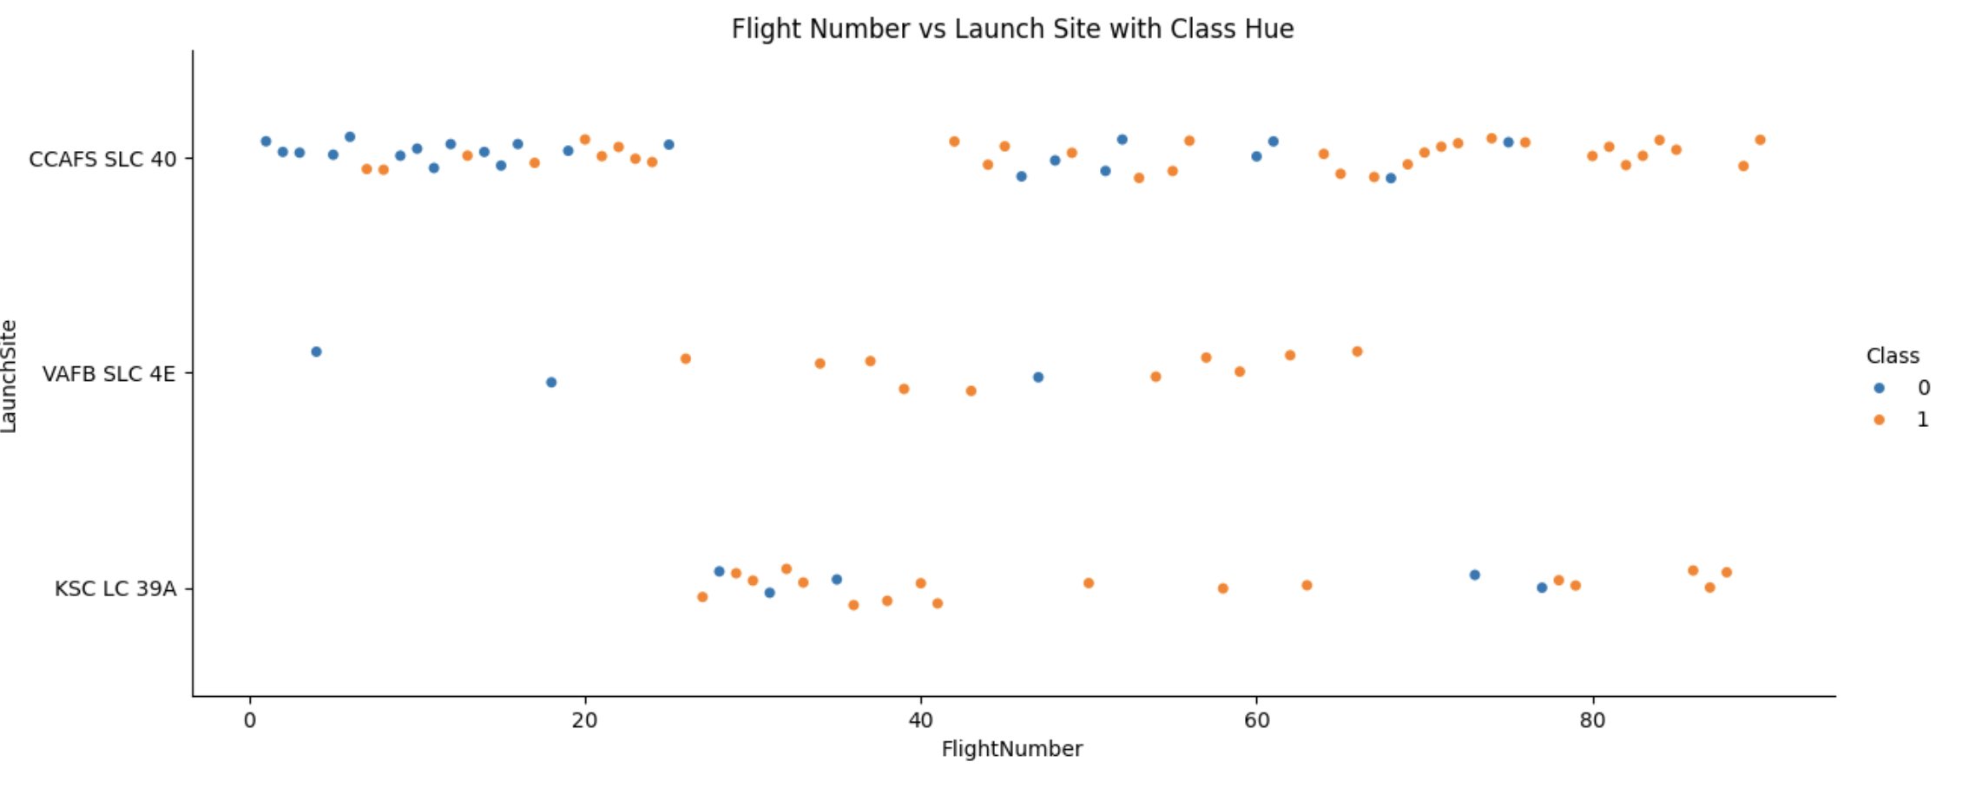
Flight Number vs. Launch Site
This scatter plot visualizes the relationship between Flight Number and Launch Site with success class indicated by color:
Blue (Class 0): Unsuccessful landings.
Orange (Class 1): Successful landings. The X-axis represents the flight number (indicating the number of attempts), and the Y-axis identifies the launch site for each launch.
Key Insights:
CCAFS SLC 40: This site shows a consistent improvement in success rates over time (flight number). As flight numbers increase, more successful landings (orange) are observed, indicating better performance with experience.
VAFB SLC 4E: There are fewer launches from this site, and most of the launches show a mixed pattern of success and failure. No clear trend of improvement is visible based on flight numbers.
KSC LC 39A: This site also shows a mixed performance across flight numbers. There are successful landings, but failures are also present even with higher flight numbers, indicating variability in performance across different launches.

Slide 22
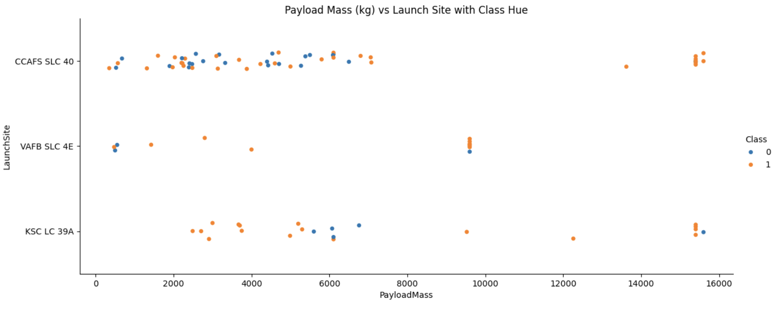
Payload vs. Launch Site
This scatter plot illustrates the relationship between Payload Mass (in kilograms) and Launch Sites with the success class as the color hue. Each point represents a SpaceX launch, where:
Blue (Class 0): Unsuccessful landings.
Orange (Class 1): Successful landings. The X-axis indicates the payload mass, while the Y-axis identifies the launch site. There are three launch sites represented: CCAFS SLC-40, VAFB SLC 4E, and KSC LC 39A.
Key Insights:
CCAFS SLC 40: This site shows a wider range of payloads, with successful landings (orange) clustering mostly around the mid to high payload range. However, we also observe failures across various payload sizes, making it a launch site with mixed results.
VAFB SLC 4E: Launches from this site tend to have lower payload masses compared to others. The majority of launches here have been successful, with only a few failures for small payloads.
KSC LC 39A:This site has a diverse payload range, including many heavier payloads.The successful launches are distributed across the payload spectrum, although failures occur at the lower and mid-range payload masses.
Payload Mass Influence: There is no clear linear relationship between payload mass and success rate at any specific launch site. Both successful and failed launches occur across a range of payload masses, suggesting that other factors (like launch conditions or orbit types) may also play a role in determining success.

Slide 23
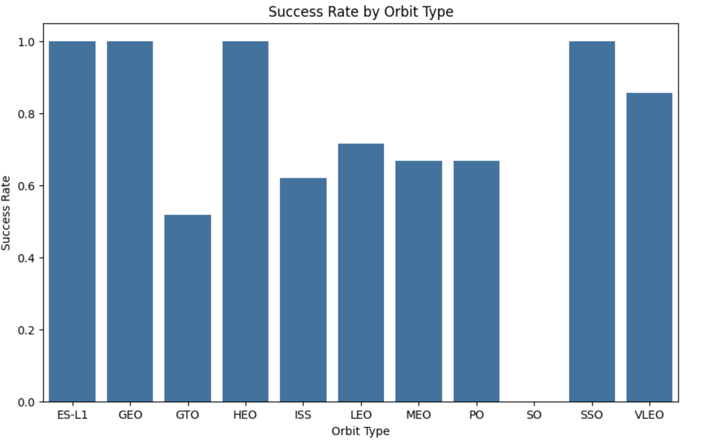
Success Rate vs. Orbit Type
This bar chart shows the success rate for different orbit types that SpaceX has launched rockets into. Each bar represents a specific orbit type (e.g., LEO, GTO, SSO), and the height of the bar reflects the percentage of successful landings for that orbit type.
X-axis: Orbit Type (e.g., LEO, GTO, SSO)
Y-axis: Success Rate (percentage of successful landings)
Key Insights:
ES-L1, GEO, HEO, and SSO orbits all share the highest success rate, suggesting that launches to these orbits have been highly reliable.
LEO, VLEO, and PO show strong success rates as well, though they are slightly lower compared to the perfect success rate of the top group.
GTO has the lowest success rate, indicating that launches to this orbit are the most challenging and prone to failure.

Slide 24
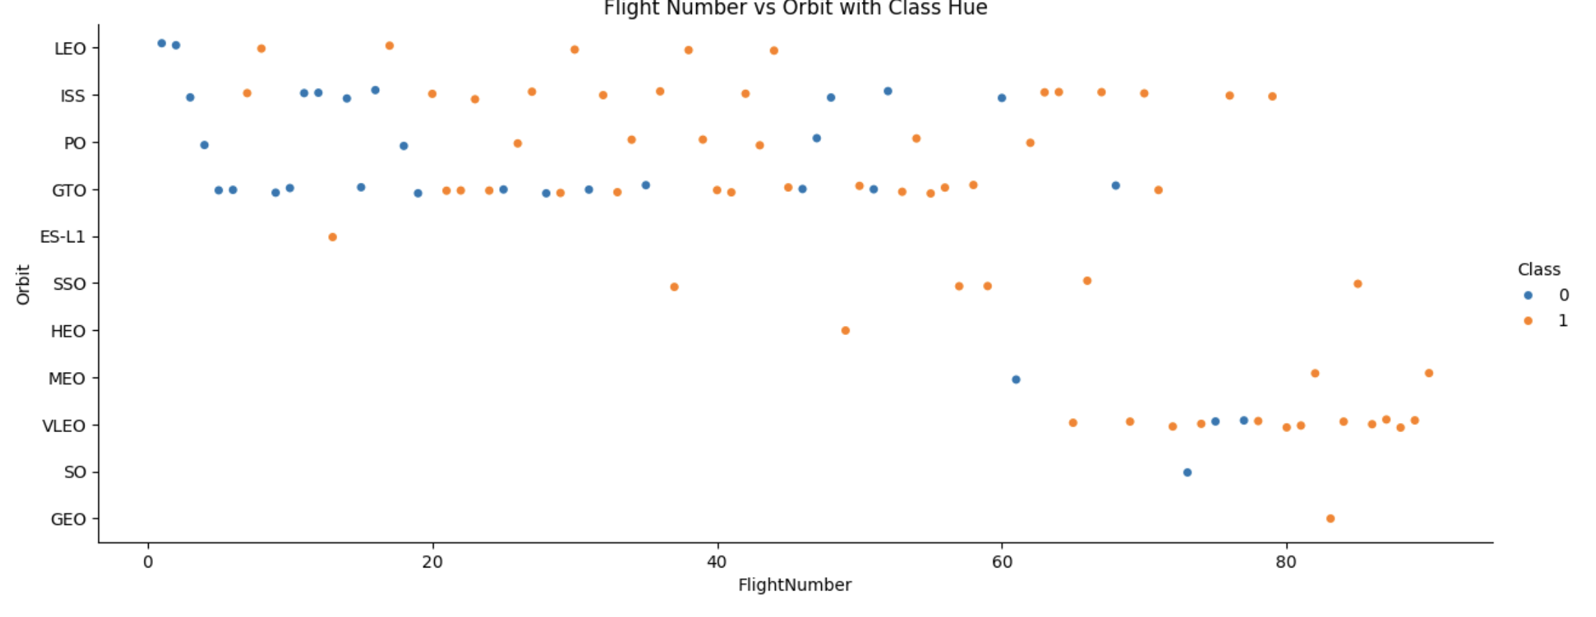
Flight Number vs. Orbit Type
This scatter plot illustrates the relationship between Flight Number and Orbit type with the class of the flight indicated by color:
Blue (Class 0): Unsuccessful landings.
Orange (Class 1): Successful landings. The X-axis represents the flight number, and the Y-axis categorizes different orbit types, such as LEO, ISS, and GTO.
Key Insights:
LEO (Low Earth Orbit): There is a clear pattern of improvement in landing success with increasing flight numbers, indicating that as more launches to LEO were made, SpaceX was able to improve the success rate.
GTO (Geostationary Transfer Orbit): The success rate remains mixed across flight numbers, indicating that flight number does not significantly affect success for this orbit. Many flights in GTO were unsuccessful.
VLEO and ISS: These orbits show an increasing success rate with higher flight numbers, with more successful landings in later flights. This suggests that operational experience positively impacted these orbits' outcomes.
Other Orbits: Some orbits like ES-L1, SSO, and GEO have a limited number of flights, so trends are less clear, but there are signs of improvement with more flights for certain orbits like SSO.

Slide 25
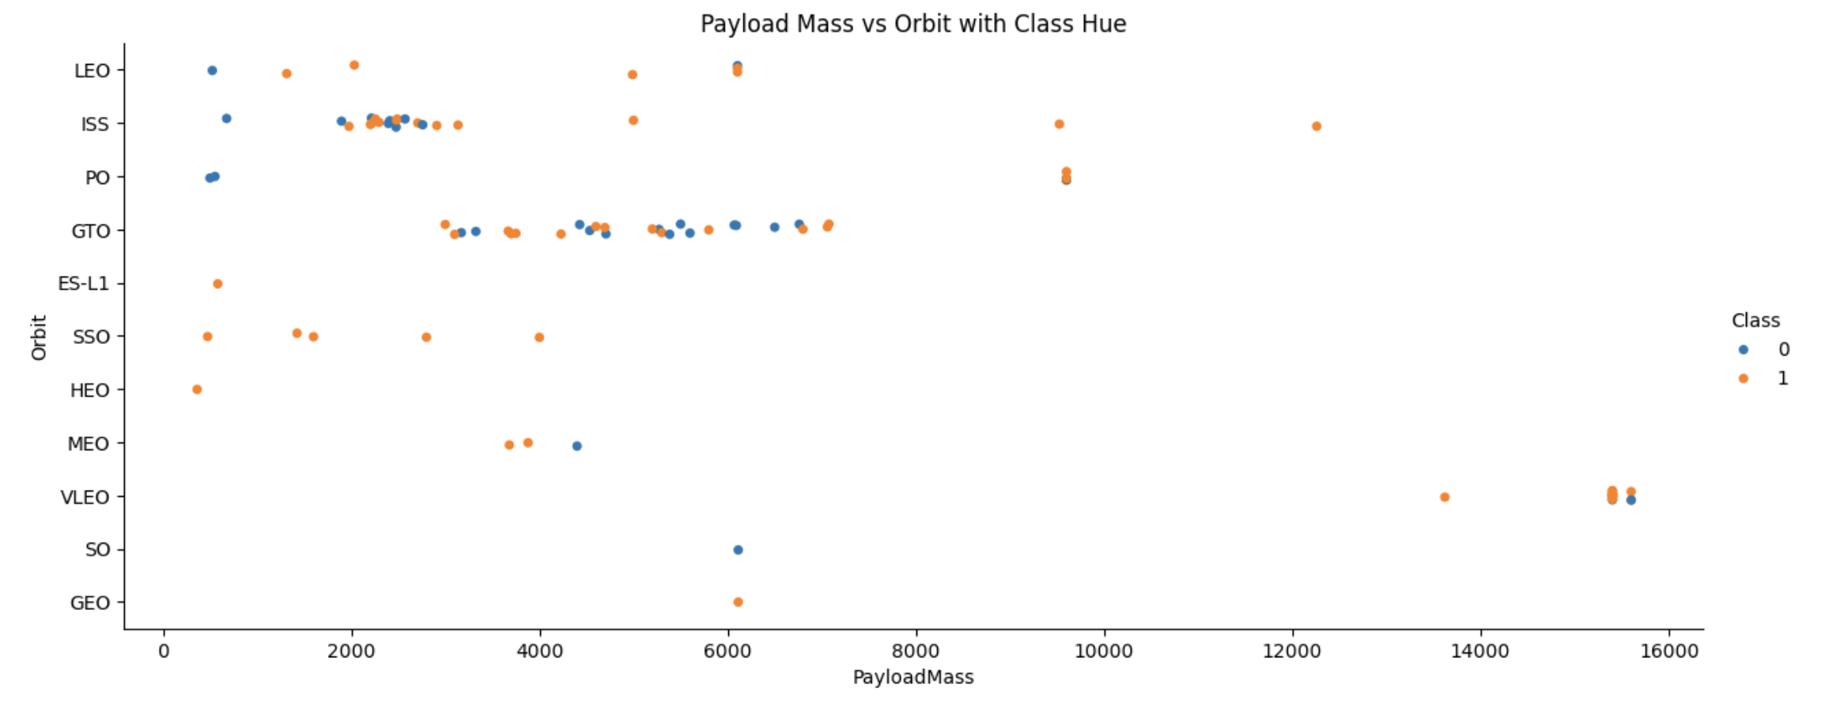
Payload vs. Orbit Type
In this scatter plot, the relationship between Payload Mass and Orbit type is examined, specifically focusing on the success (Class) of each launch.
X-axis: Payload Mass (kg)
Y-axis: Orbit Type
Class 1 (Orange): Successful landings
Class 0 (Blue): Unsuccessful landings
Key Insights:
Polar, LEO, and ISS Orbits: Heavier payloads in these orbits (Payload Mass > 10,000 kg) have a relatively higher rate of successful landings. The orange dots representing successful missions dominate these orbits, indicating a positive trend for handling larger payloads.
GTO Orbit: The results in GTO (Geostationary Transfer Orbit) show both successful and unsuccessful landings with a wide range of payload masses. This suggests greater variability in landing outcomes, making it harder to clearly distinguish whether heavier payloads affect success in GTO.

Slide 26
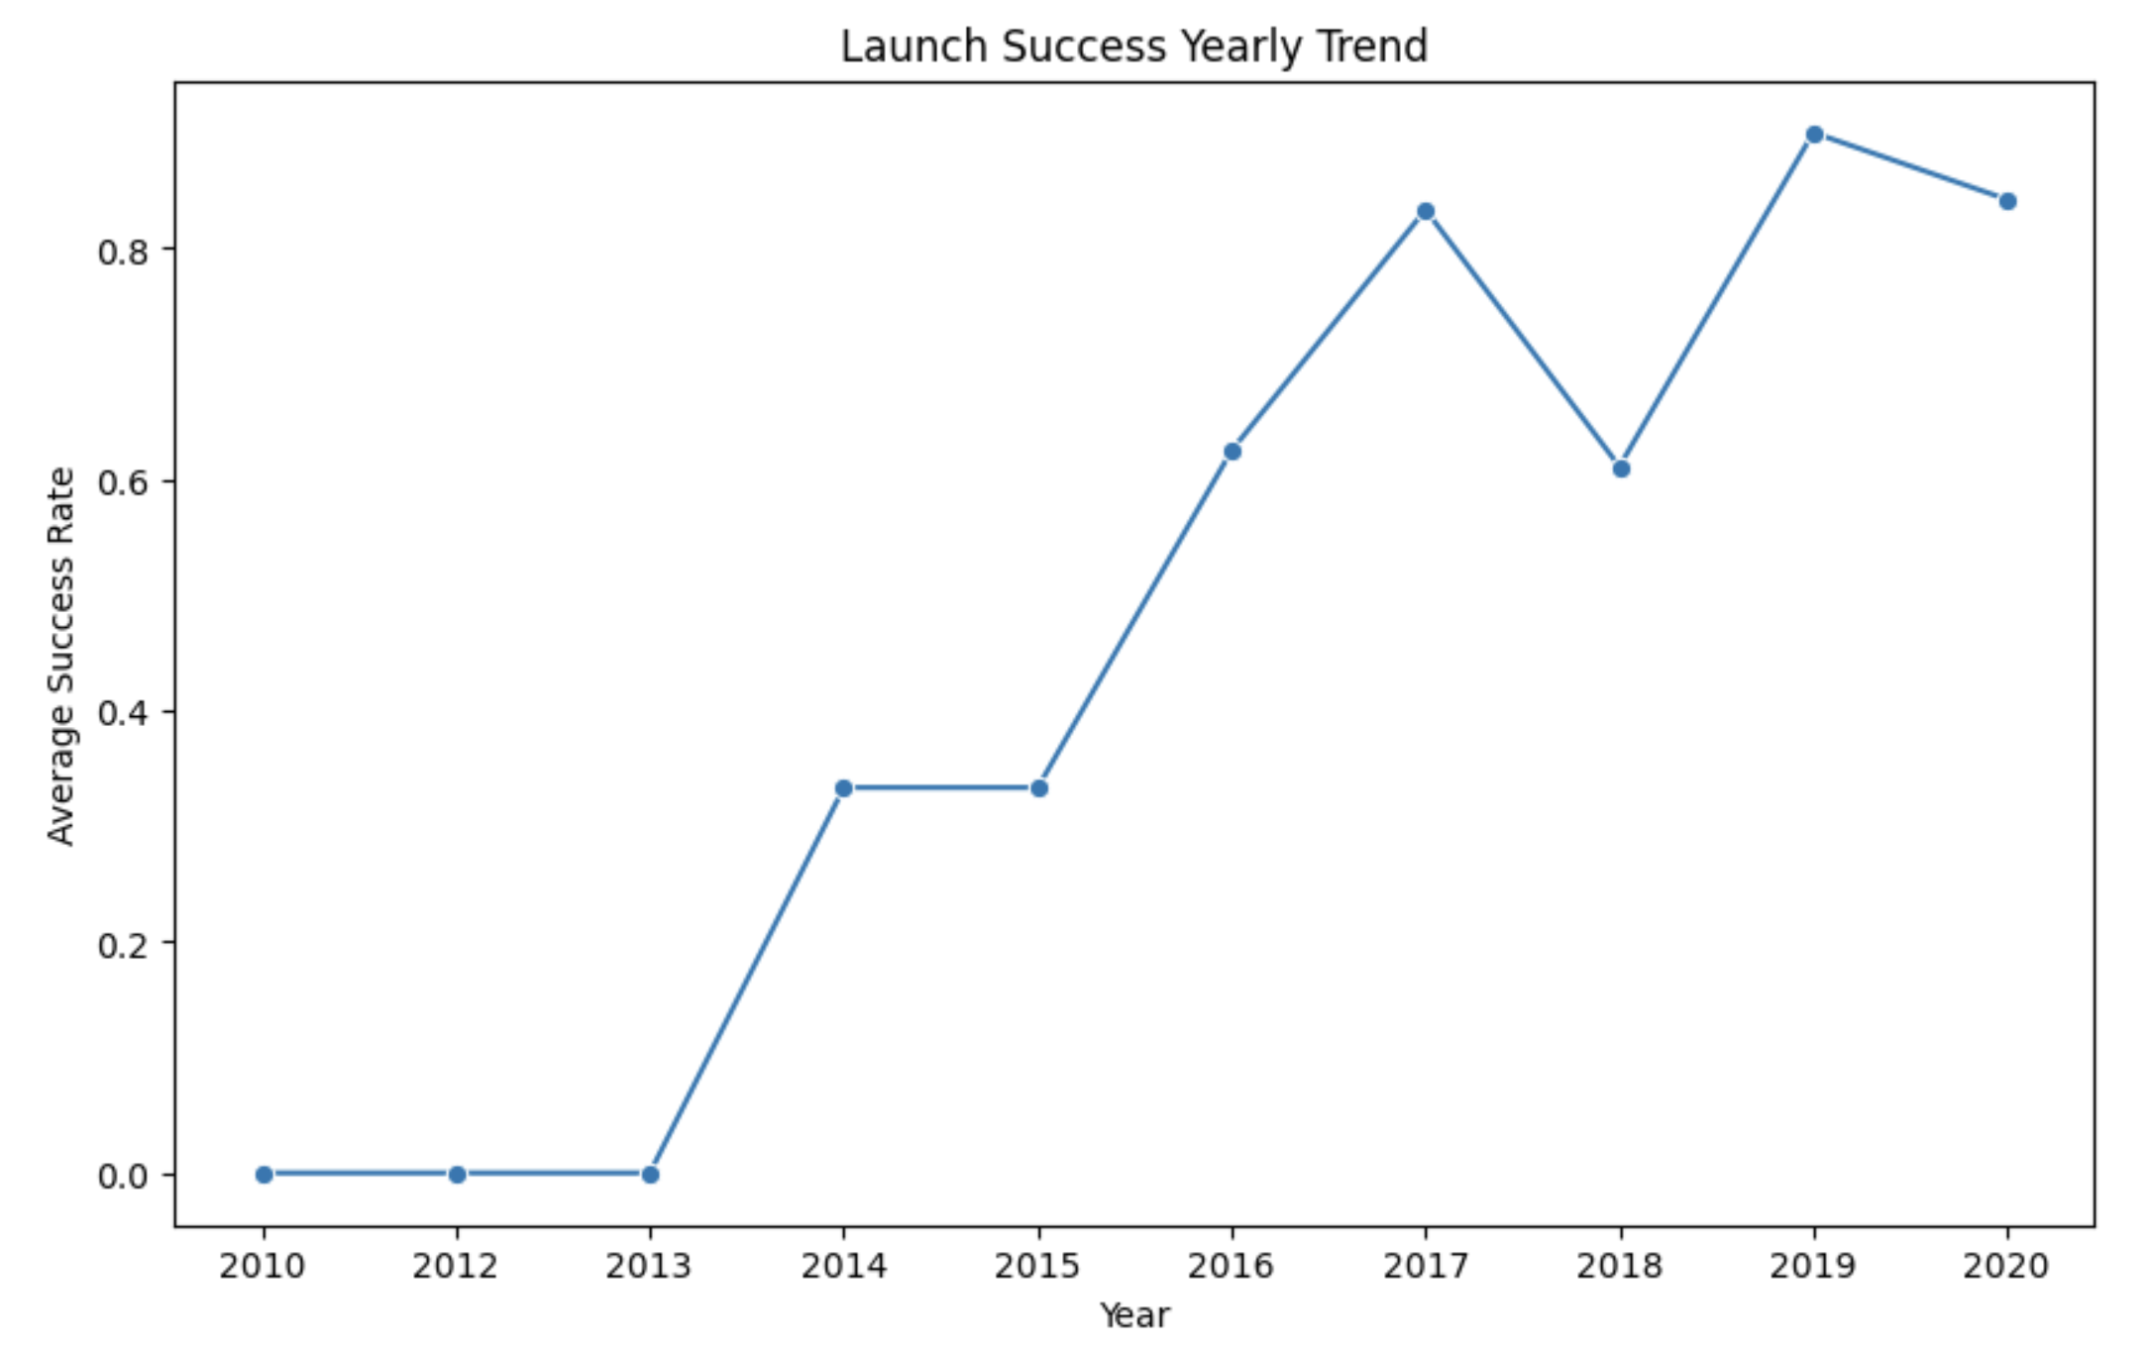
Launch Success Yearly Trend
This line chart depicts the yearly trend of the average launch success rate for SpaceX from 2010 to 2020.
X-axis: Year (2010-2020)
Y-axis: Average Success Rate (ranging from 0.0 to 1.0)
Key Insight:
From 2013 onwards, the success rate began to climb steadily.
By 2015, the success rate saw a significant jump, with each subsequent year showing consistent improvement.
The peak success rate occurred in 2019, reaching close to 90%, before a slight dip in 2020.

Slide 27
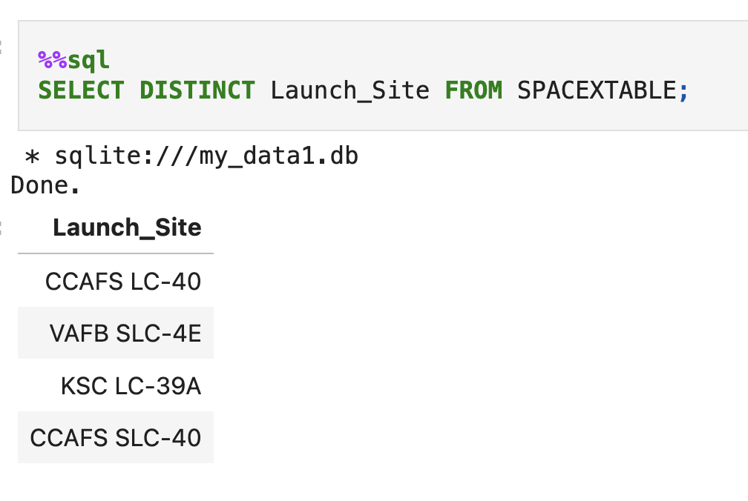
All Launch Site Names
The query retrieves the unique names of all launch sites where SpaceX launches occurred. There are three distinct launch sites in the dataset: CCAFS SLC 40 (Cape Canaveral), VAFB SLC 4E (Vandenberg Air Force Base), and KSC LC 39A (Kennedy Space Center). Each site represents a different geographic location used for launching SpaceX rockets.

Slide 28
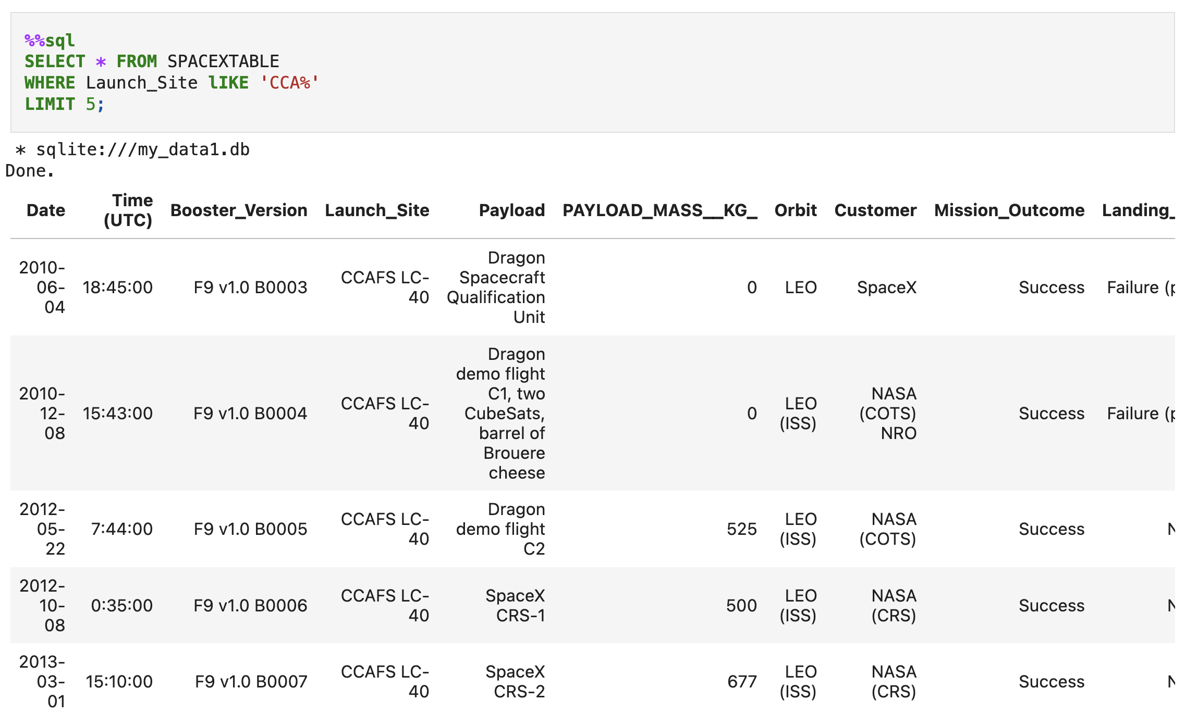
Launch Site Names Begin with 'CCA'
The query selects the first 5 records where the launch site name begins with 'CCA', which corresponds to CCAFS SLC 40 (Cape Canaveral). This site is one of the primary launch sites for SpaceX, and the records show different missions, payloads, and their success or failure outcomes. The LIKE 'CCA%' condition ensures only launch sites that start with 'CCA' are retrieved.

Slide 29
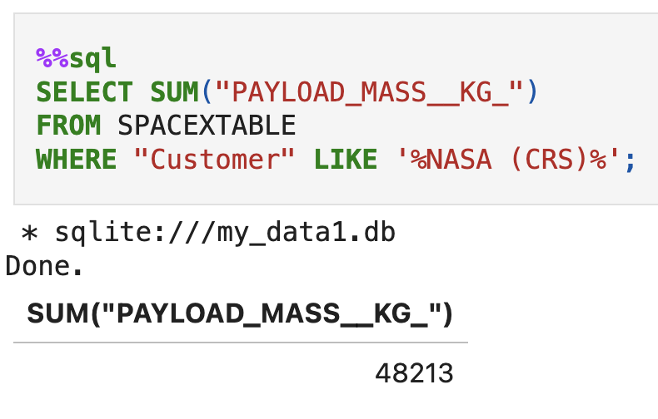
Total Payload Mass
The query calculates the total payload mass carried by boosters that were launched by NASA. The SUM(PayloadMass) function adds up the payloads for all NASA-related launches. In this case, the total payload is 48,213 kg across all missions launched for NASA.

Slide 30
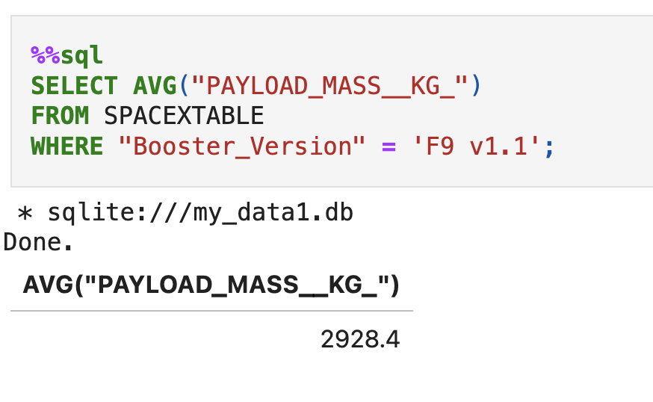
Average Payload Mass by F9 v1.1
The query calculates the average payload mass carried by the F9 v1.1 booster version. The AVG(PayloadMass) function computes the average of the payloads for all missions launched using the F9 v1.1 booster. In this case, the average payload mass is 2,928.4 kg.

Slide 31
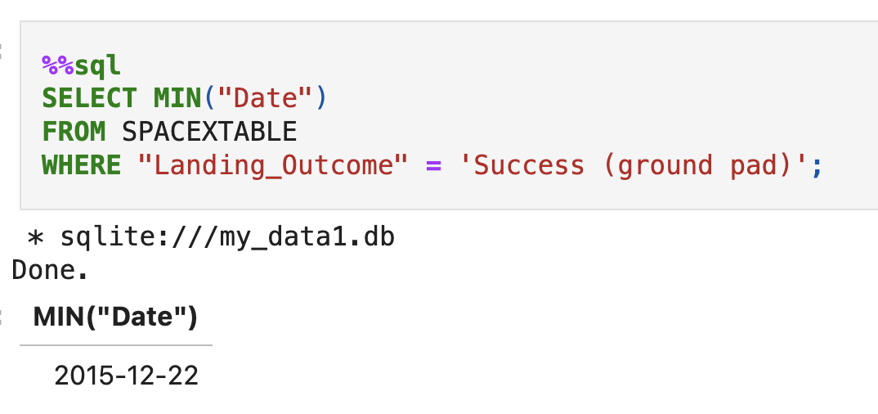
First Successful Ground Landing Date
The query finds the earliest date (using MIN(Date)) when a successful landing was achieved on a ground pad. The condition Landing_Outcome = 'Success' filters only the successful landings, and the condition Landing_Pad = 'Ground Pad' ensures that only landings on ground pads are considered. The result indicates that the first successful landing on a ground pad occurred on December 22, 2015.

Slide 32
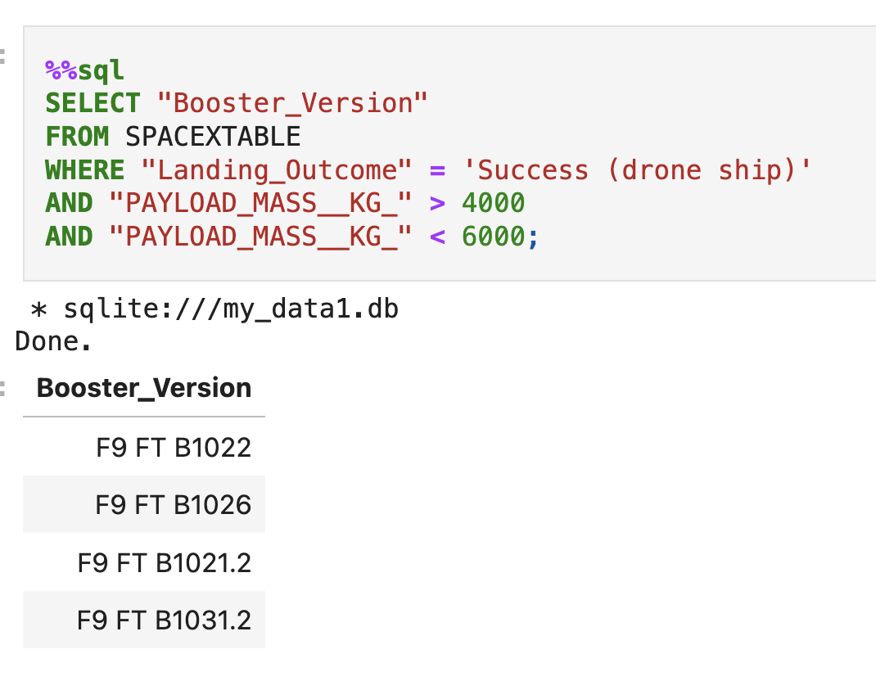
Successful Drone Ship Landing with Payload between 4000 and 6000
The query retrieves the names of booster versions that have successfully landed on a drone ship and had a payload mass between 4000 and 6000 kg. The conditions ensure that only those missions with a successful landing on a drone ship and within the specified payload range are listed.

Slide 33
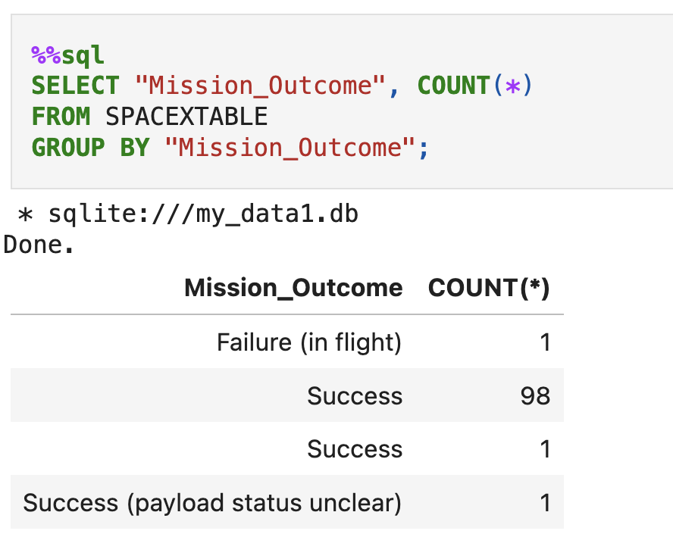
Total Number of Successful and Failure Mission Outcomes
This query calculates the total number of successful and failed mission outcomes by grouping the data based on the Landing_Outcome. It counts the occurrences of each outcome (either 'Success' or 'Failure') using the COUNT(*) function.

Slide 34
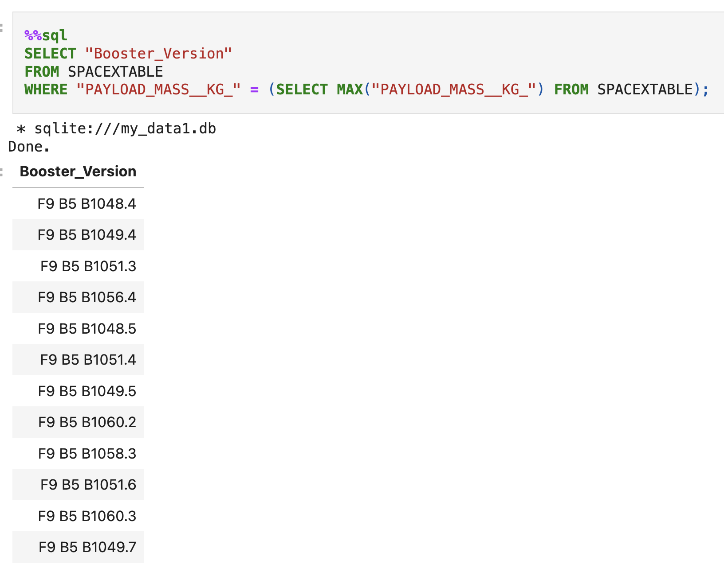
Boosters Carried Maximum Payload
This query retrieves the booster version that carried the maximum payload mass from the SPACEXTABLE. The subquery first finds the maximum value of PAYLOAD_MASS__KG_ using the MAX() function. The outer query then selects the Booster_Version where the payload mass matches this maximum value.

Slide 35
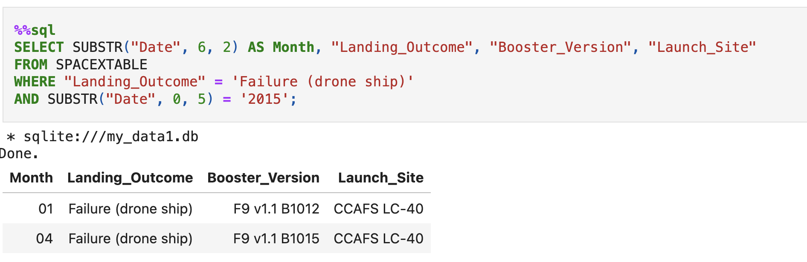
2015 Launch Records
This query extracts the month, landing outcome, booster version, and launch site for all records where the landing outcome was "Failure (drone ship)" in the year 2015. The SUBSTR() function is used to filter the year 2015 from the "Date" field and also to extract the month from the date. The result shows two failed drone ship landings for F9 v1.1 at the CCAFS sites during the months of January and April of 2015.

Slide 36
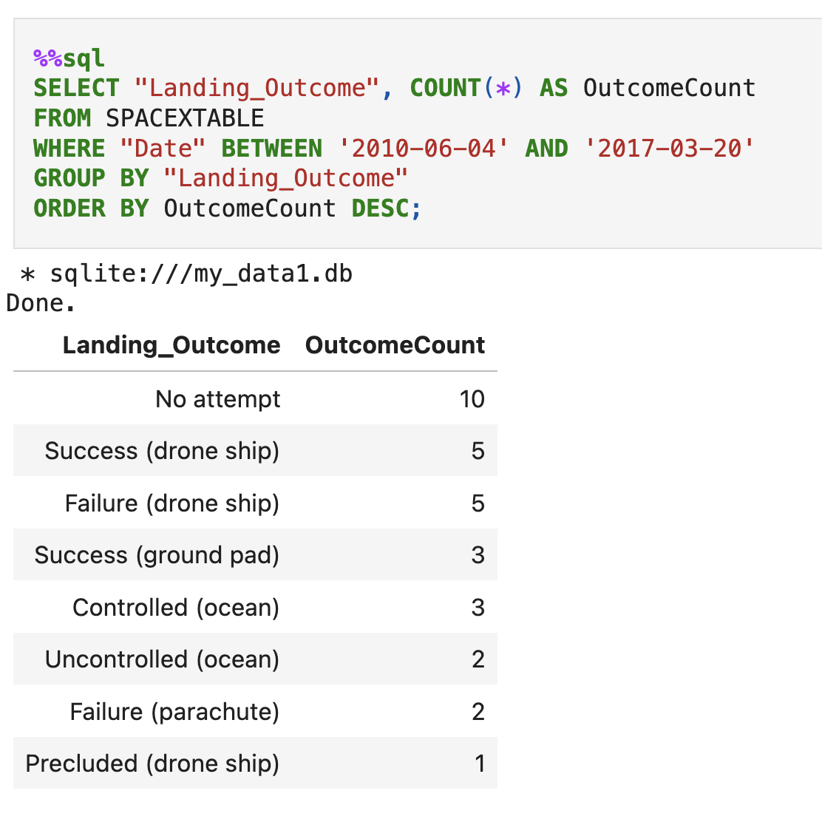
Rank Landing Outcomes Between 2010-06-04 and 2017-03-20
This query ranks the landing outcomes between the date range of June 4, 2010, and March 20, 2017, in descending order of frequency. It groups the results by the "Landing_Outcome" field and counts the occurrences of each outcome. The results allow you to see which landing outcomes, such as 'Failure (drone ship)' or 'Success (ground pad)', occurred most frequently during this period.

Slide 37

Section 3

Slide 38
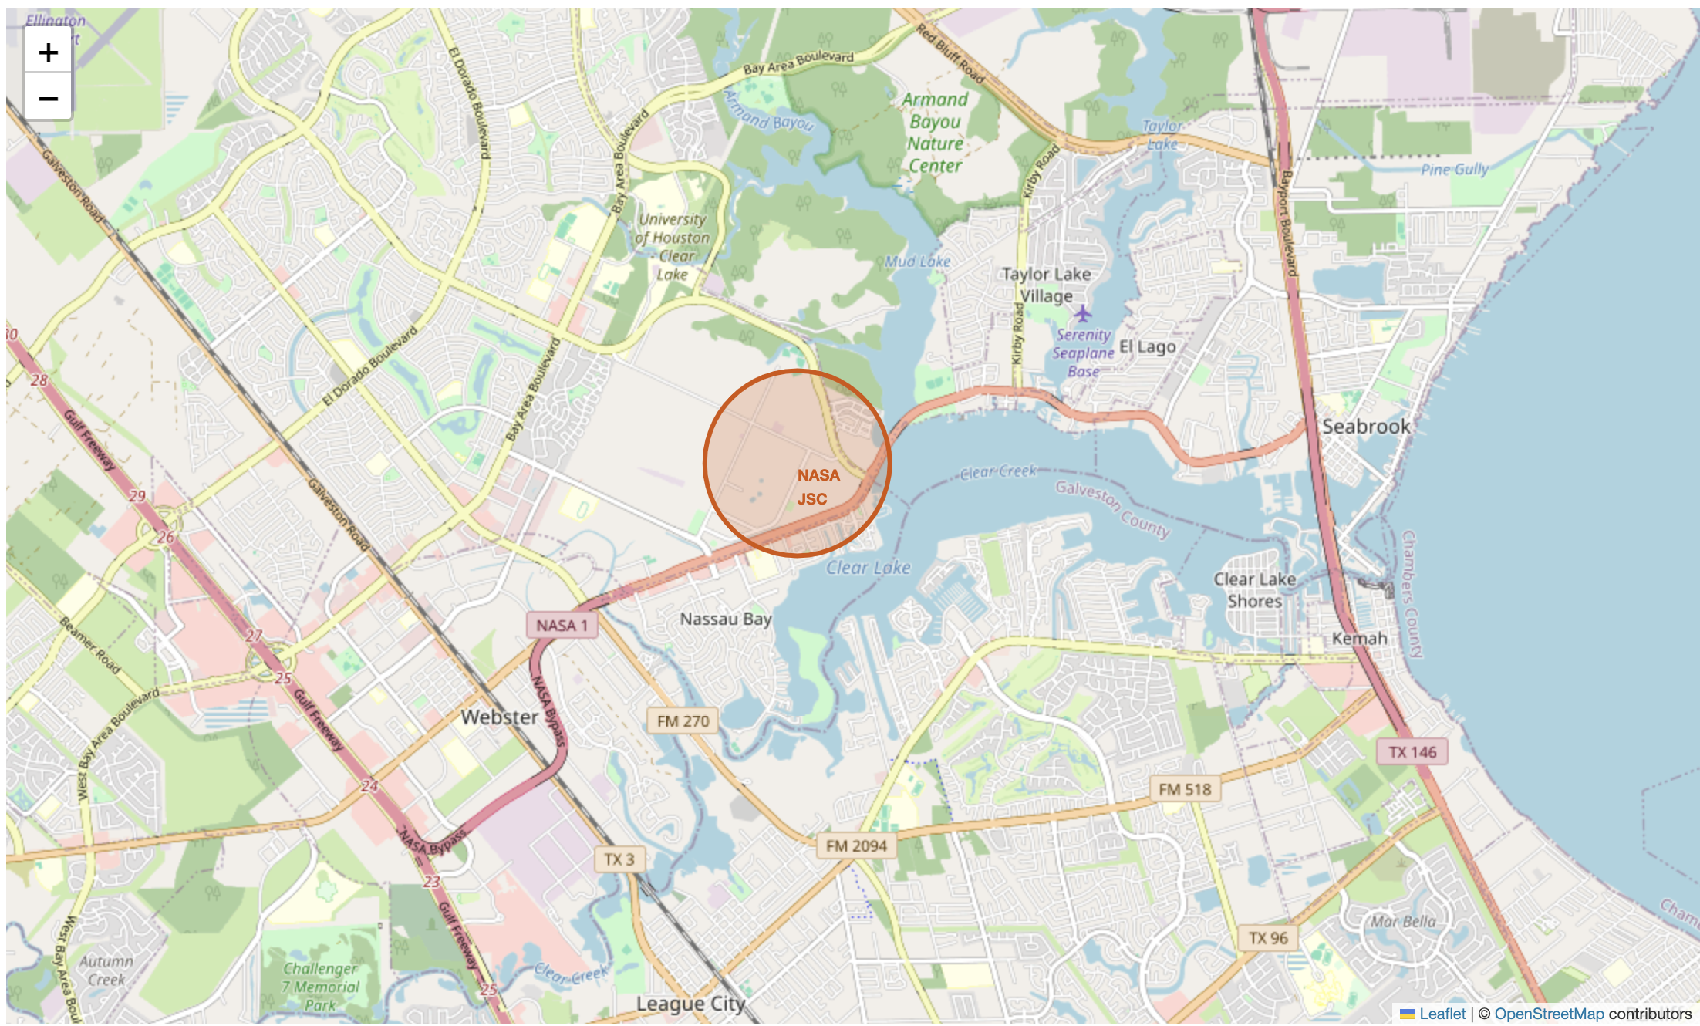
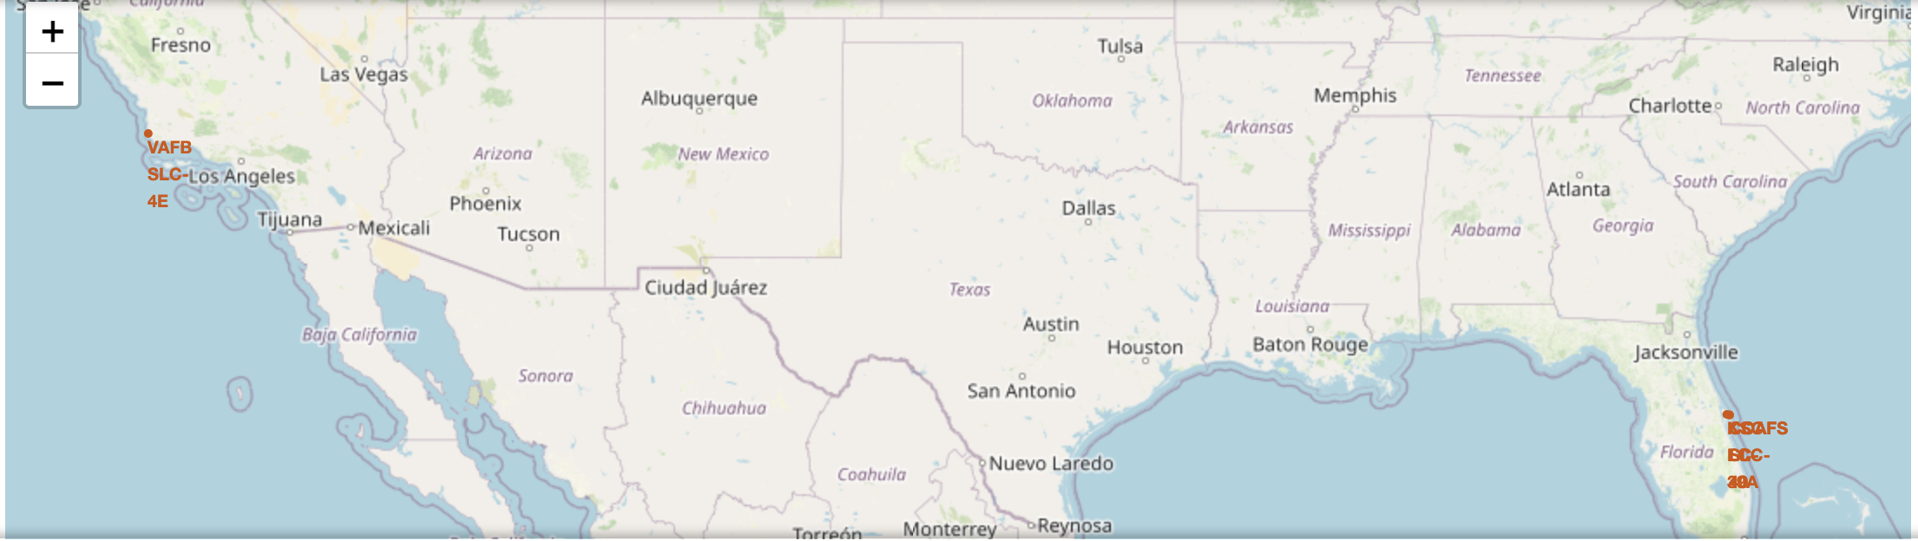
Mark all launch sites on a map
Replace <Folium map screenshot 1> title with an appropriate title
Explore the generated folium map and make a proper screenshot to include all launch sites’ location markers on a global map
Explain the important elements and findings on the screenshot

Slide 39
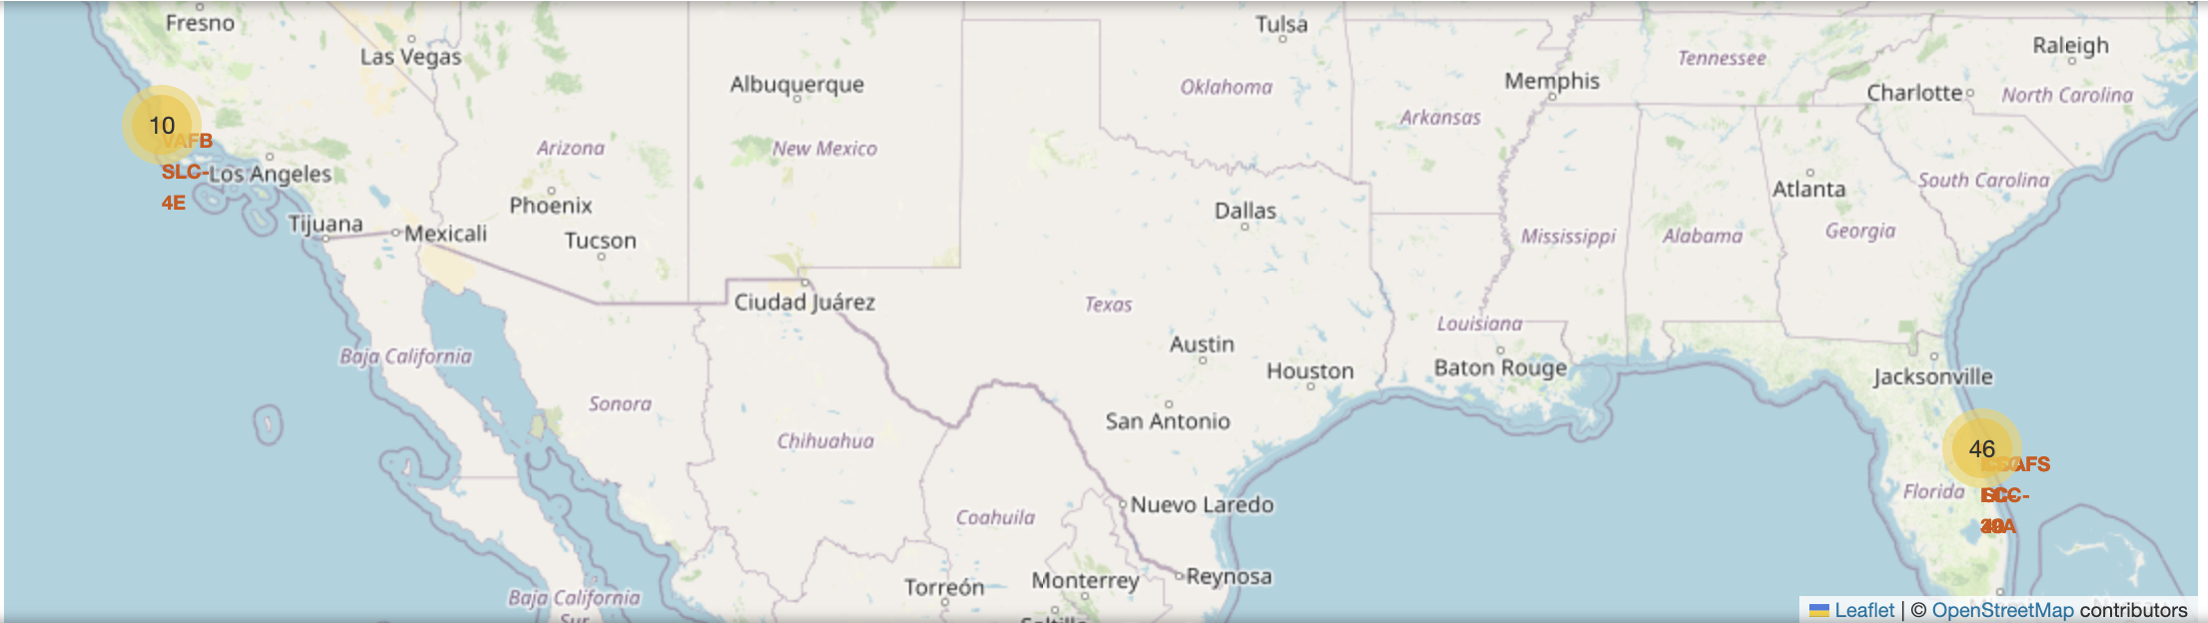
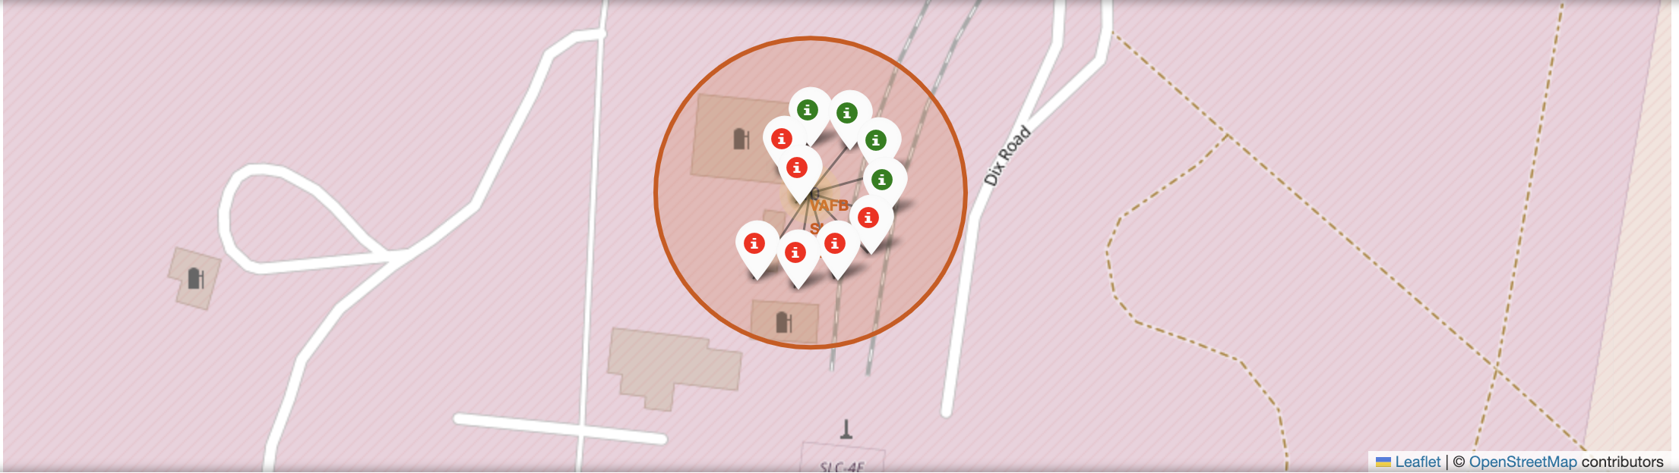
Mark the success/failed launches for each site on the map
Replace <Folium map screenshot 2> title with an appropriate title
Explore the folium map and make a proper screenshot to show the color-labeled launch outcomes on the map
Explain the important elements and findings on the screenshot

Slide 40
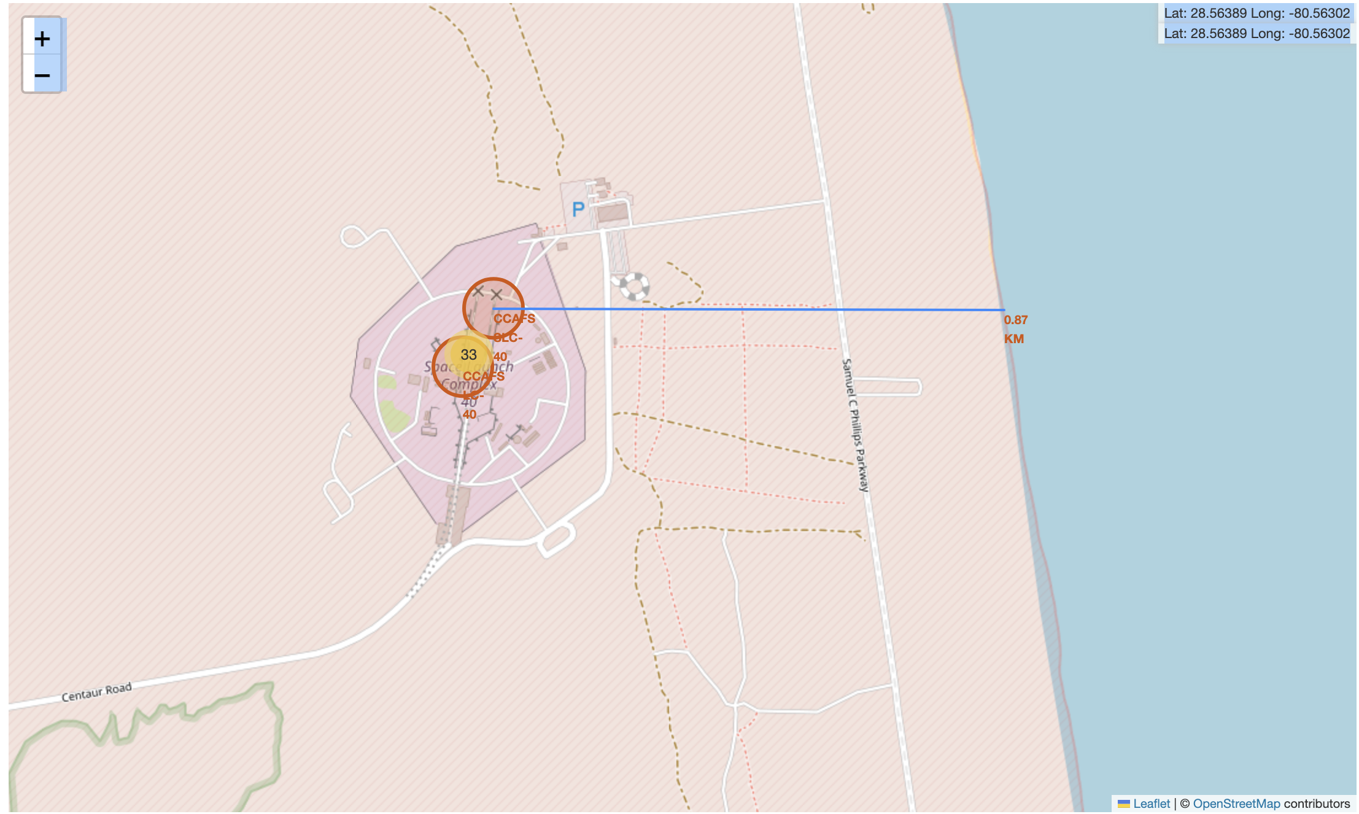
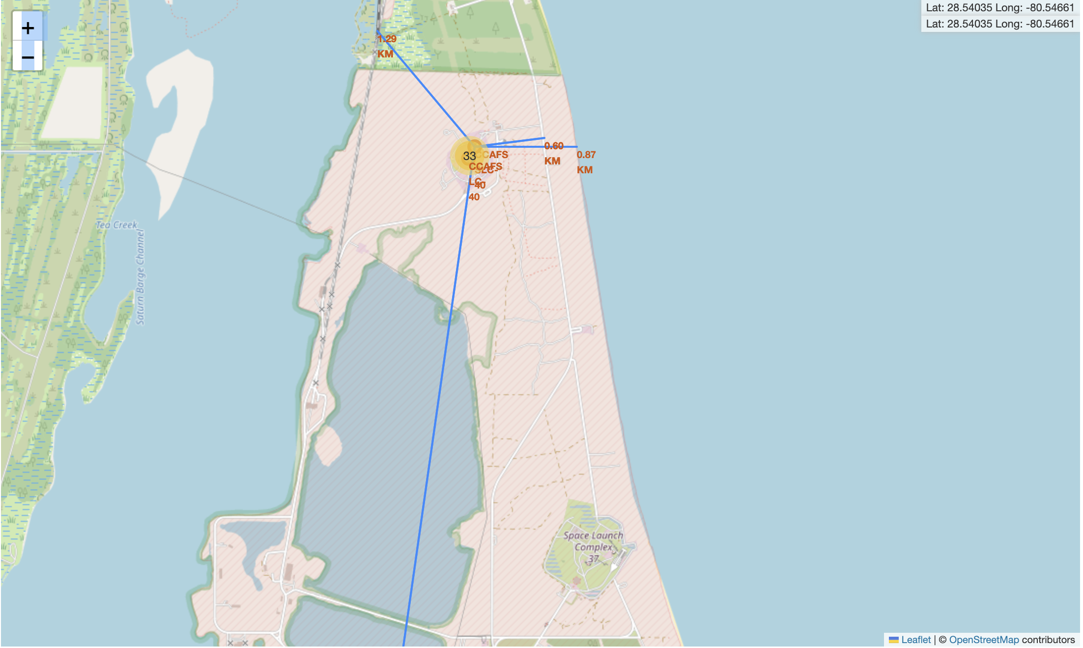
Calculate the distances between a launch site to its proximities
Replace <Folium map screenshot 3> title with an appropriate title
Explore the generated folium map and show the screenshot of a selected launch site to its proximities such as railway, highway, coastline, with distance calculated and displayed
Explain the important elements and findings on the screenshot

Slide 41

Section 4

Slide 42
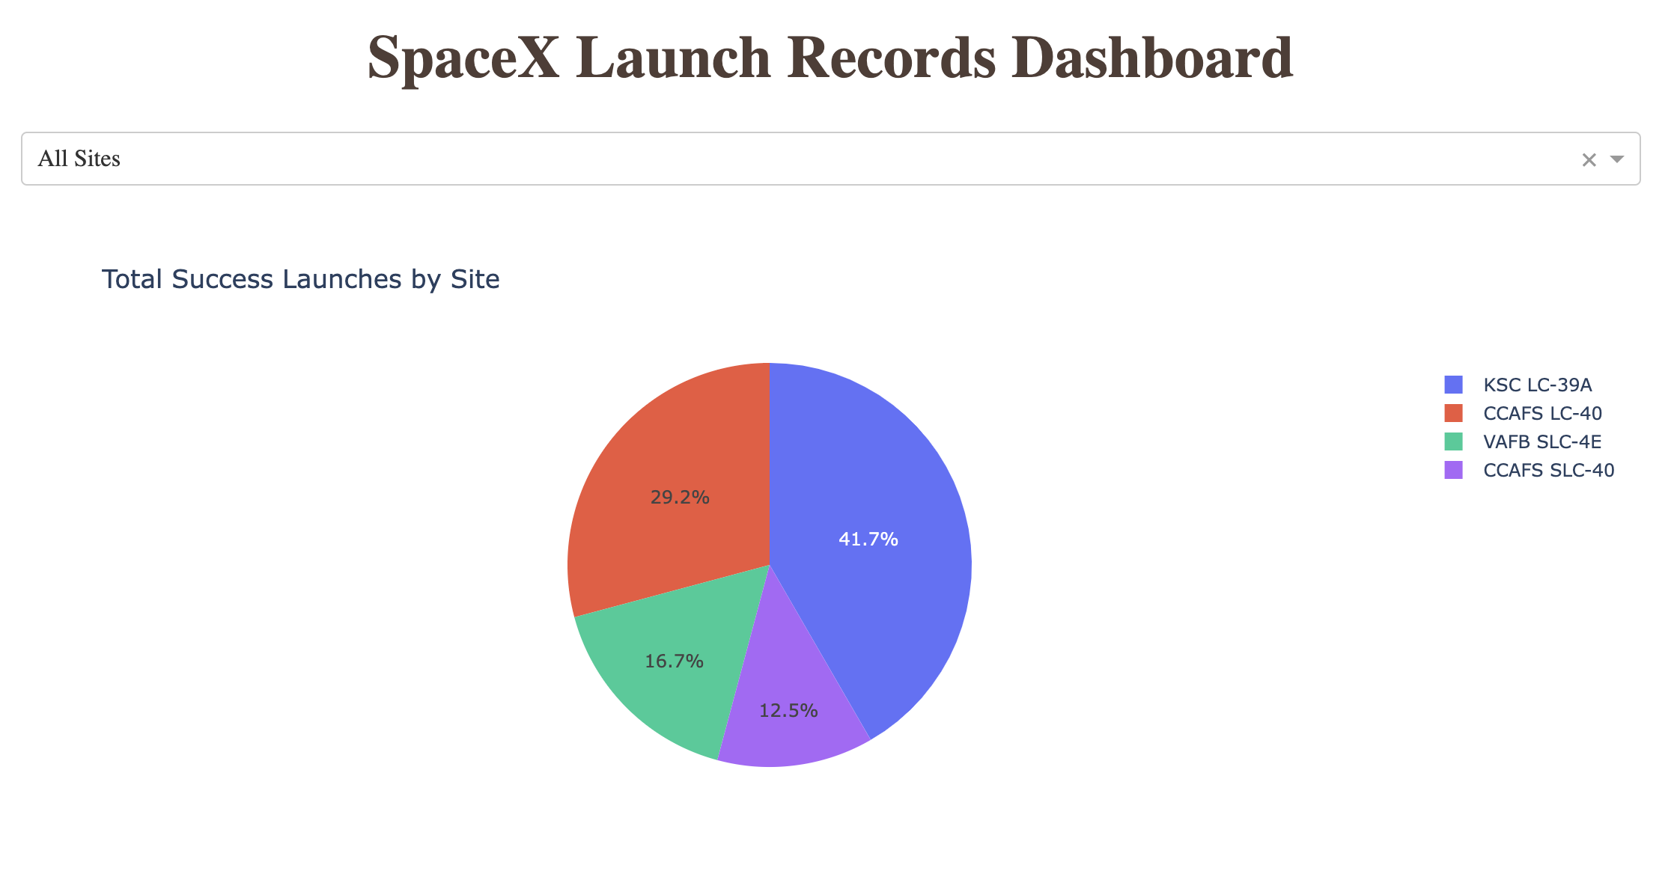
launch success count for all sites
Explanation of Important Elements and Findings:
Dropdown Menu (All Sites) This dropdown allows users to filter the results by specific launch sites, or view data for all sites combined. In this screenshot, "All Sites" is selected, showing the total success launches across all SpaceX launch sites.
Pie Chart: Total Success Launches by Site The pie chart visualizes the distribution of successful launches across four key SpaceX launch sites:
KSC LC-39A: Represented by the blue segment, this site accounts for 41.7% of total successful launches.
CCAFS LC-40: Represented by the red segment, this site accounts for 29.2% of total successful launches.
VAFB SLC-4E: Represented by the green segment, this site accounts for 16.7% of total successful launches.
CCAFS SLC-40: Represented by the purple segment, this site accounts for 12.5% of total successful launches.
Key Insight: The majority of successful launches were conducted from the KSC LC-39A site, which represents over 40% of the total successful launches. Other significant sites include CCAFS LC-40 and VAFB SLC-4E, but KSC LC-39A appears to be the most frequently successful launch site.

Slide 43
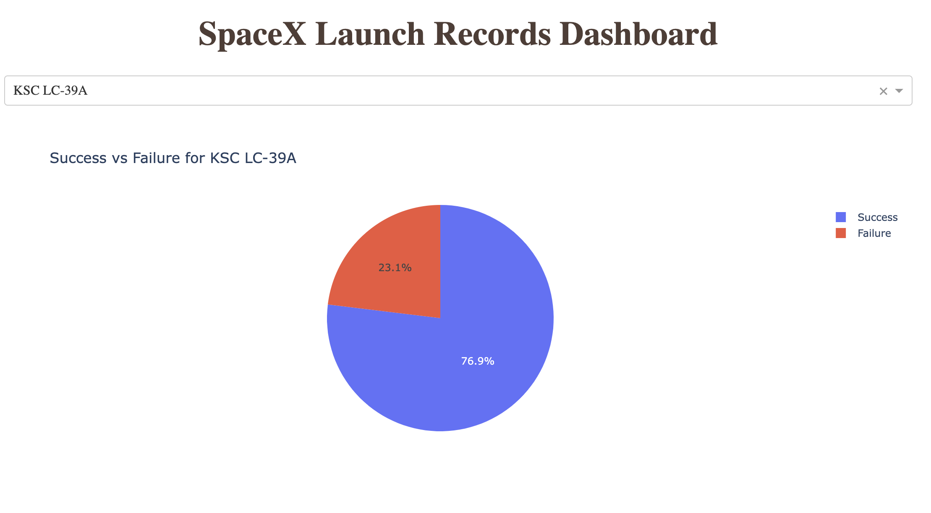
the launch site with highest launch success ratio
Explanation of Important Elements and Findings:
Dropdown Menu (KSC LC-39A) The dropdown is set to "KSC LC-39A," which filters the results specifically to show data for launches from the Kennedy Space Center Launch Complex 39A.
Pie Chart: Success vs. Failure for KSC LC-39A This pie chart visualizes the proportion of successful versus failed launches for KSC LC-39A. The chart uses two colors:
Blue (Success): Represents 76.9% of launches from KSC LC-39A that were successful.
Red (Failure): Represents 23.1% of launches from KSC LC-39A that failed.
Key Insight:
The majority of launches from KSC LC-39A were successful, with nearly 77% success rate. Only around 23% of launches failed, indicating a high success rate at this launch site.

Slide 44
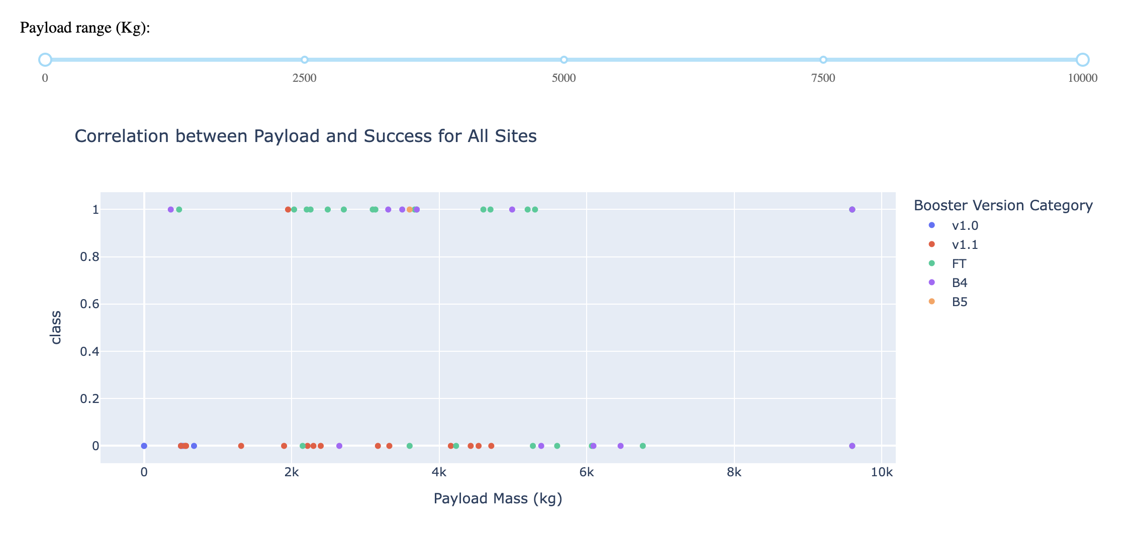
Payload vs. Launch Outcome scatter plot for all sites(1/4)
Low Payload Range (0 to 2500 kg):
Observation: In the low payload range (0 to 2500 kg), a high success rate is seen across multiple booster versions such as v1.1 and FT.
Key Insight: Smaller payloads appear to be well-handled by most booster versions, showing almost consistent success, particularly for versions FT and B4.

Slide 45
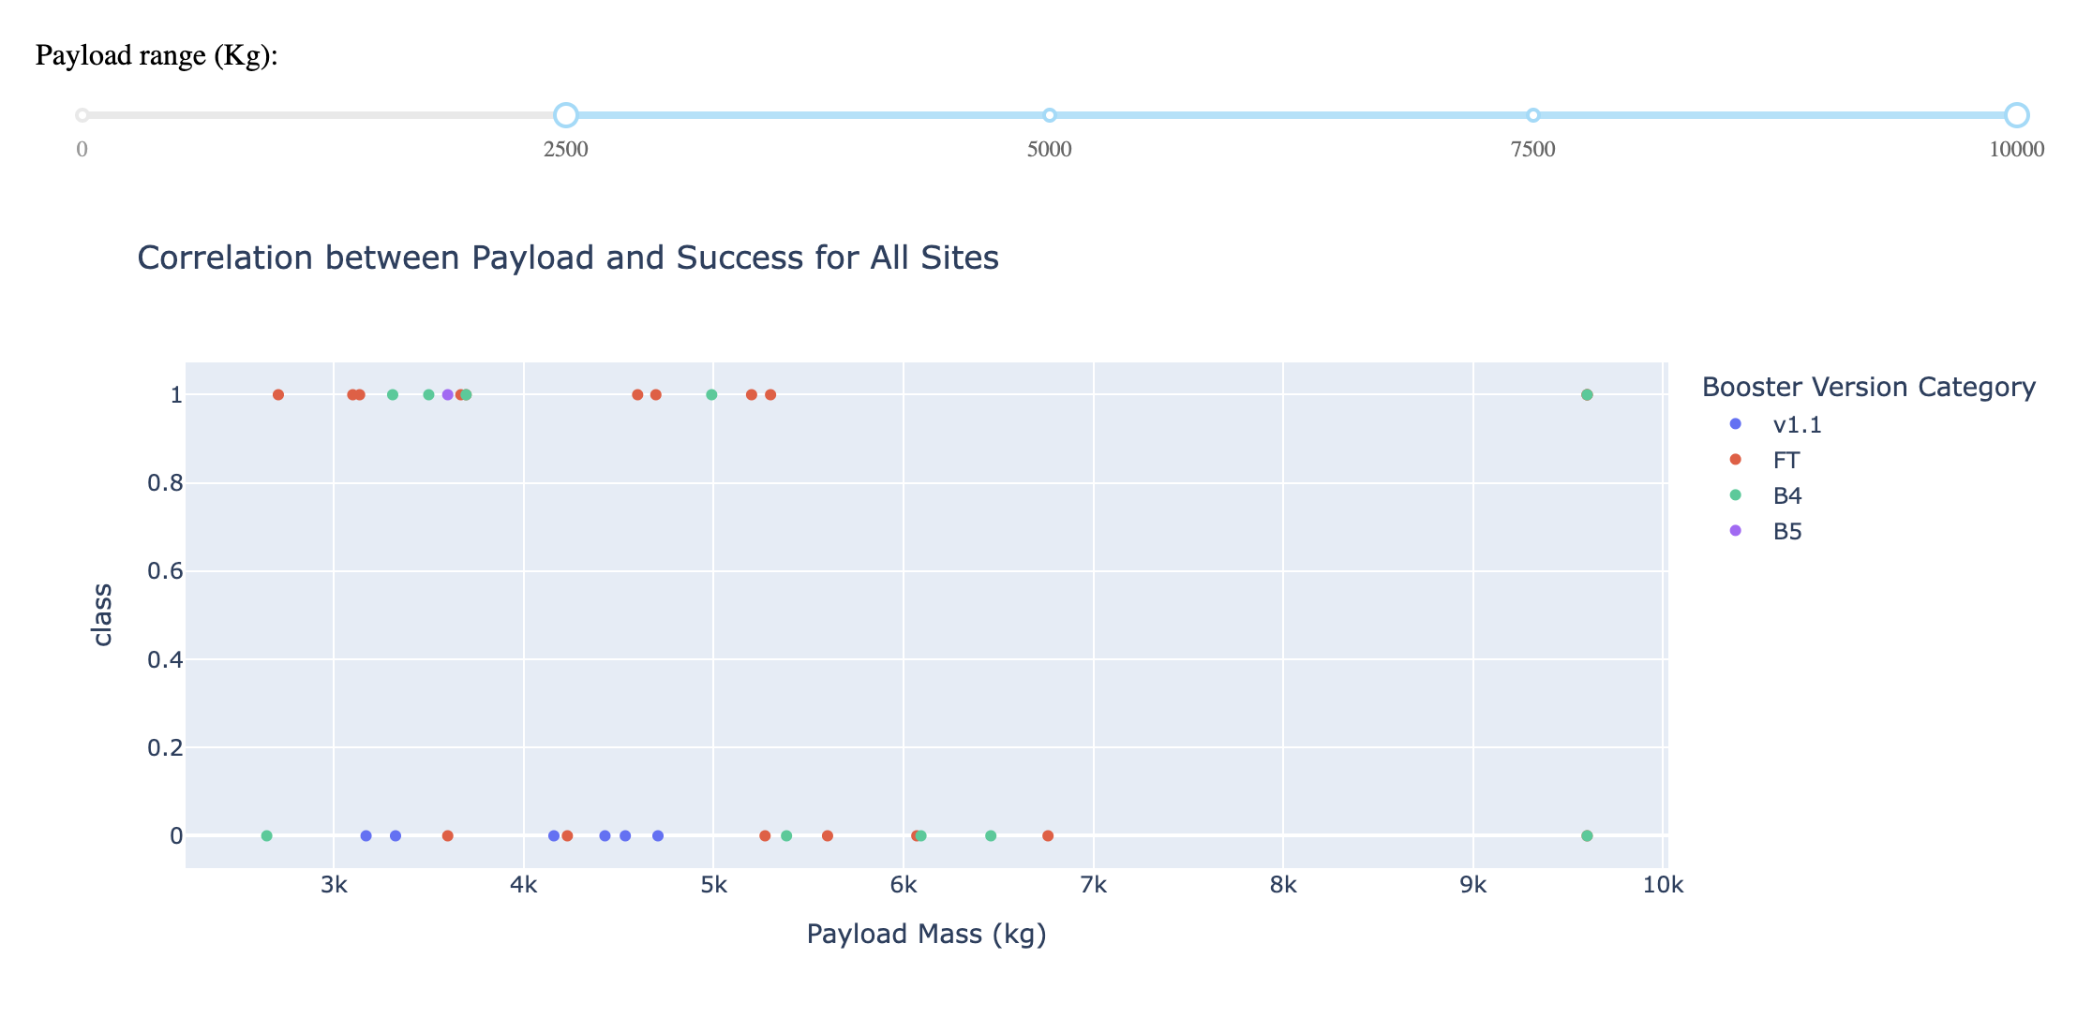
Payload vs. Launch Outcome scatter plot for all sites(2/4)
Mid Payload Range (2500 kg to 5000 kg):
Observation: For payloads between 2500 kg to 5000 kg, booster versions such as FT and B4 continue to show a high success rate. Some failures are still observed in this range, but the overall trend is that of high success.
Key Insight: Payloads within this mid-range demonstrate reliable performance for newer booster versions (e.g., B4), indicating technological improvements for mid-weight payloads.

Slide 46
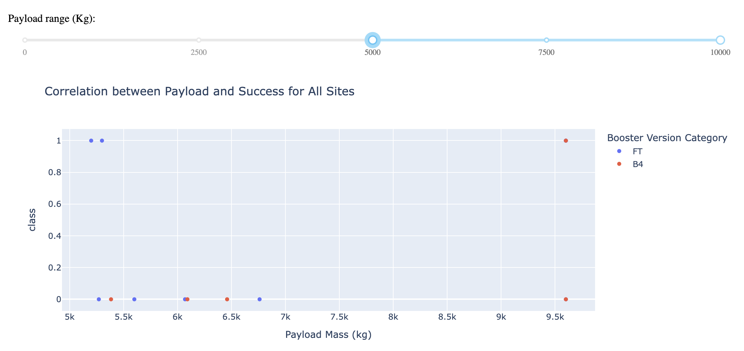
Payload vs. Launch Outcome scatter plot for all sites(3/4)
Higher Payload Range (5000 kg to 7500 kg):
Observation: As the payload weight increases, fewer data points are present. The success rate is still high for certain booster versions, such as FT and B4, though failures are seen for heavier payloads.
Key Insight: As payload mass increases, the success rate still remains robust for modern booster versions, particularly for payloads handled by FT and B4 versions. However, there are some failures, indicating that very high payloads may introduce challenges.

Slide 47
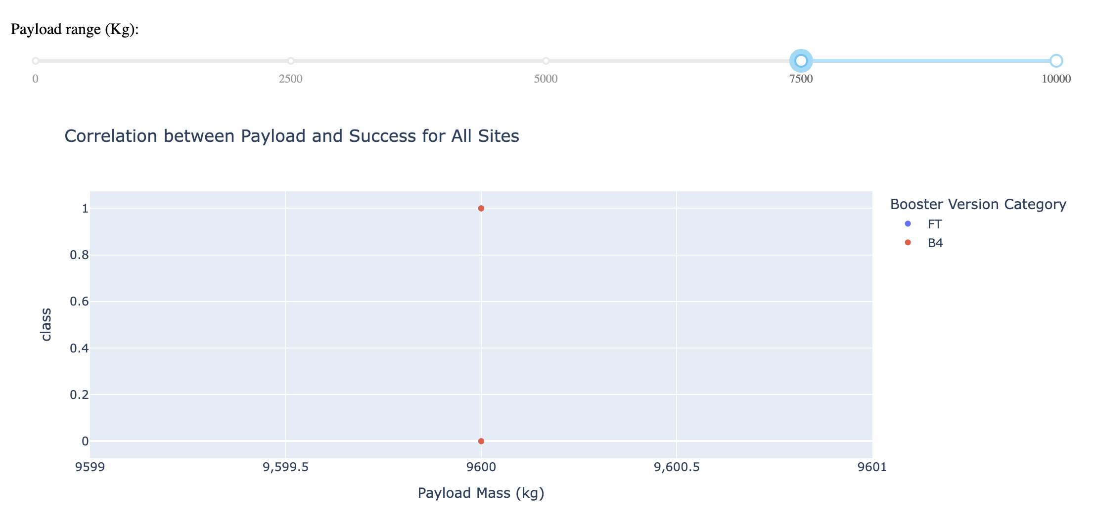
Payload vs. Launch Outcome scatter plot for all sites(4/4)
Very High Payload Range (7500 kg to 10,000 kg):
Observation: In the highest payload range, we see mostly newer booster versions such as B4 and B5 handling the launches, with a high success rate. The data points for this range are fewer, but it’s clear that the larger payloads are successfully managed by the latest technologies.
Key Insight: The highest payloads are exclusively handled by newer booster versions like B4 and B5, showing the technological advancements in handling larger payloads with high success.

Slide 48

Section 5

Slide 49
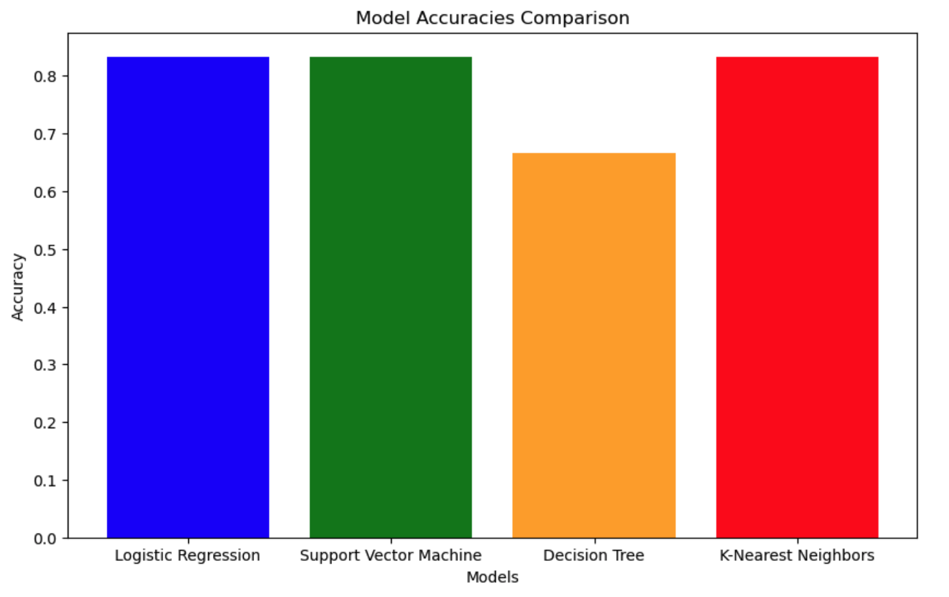
Classification Accuracy
The classification accuracy comparison shows the performance of different models: Logistic Regression, Support Vector Machine, Decision Tree, and K-Nearest Neighbors. Based on the graph:
Logistic Regression, Support Vector Machine, and K-Nearest Neighbors all have the same highest accuracy at approximately 0.83.
The Decision Tree model has the lowest accuracy at approximately 0.67.
The explanation here is that Logistic Regression, Support Vector Machine, and K-Nearest Neighbors all performed similarly, and any of these models can be considered the best in terms of accuracy for this particular dataset. The Decision Tree model underperformed compared to the other three models.

Slide 50
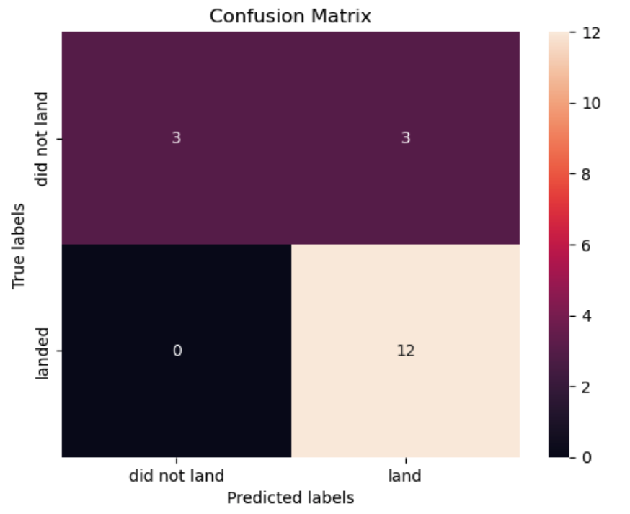
Confusion Matrix
True Positives (TP): These are cases where the true label is "landed" and the model also predicted "landed" correctly. In your case, there are 12 true positives. This means the model made 12 correct predictions where a successful landing was correctly identified.
False Positives (FP): These are cases where the true label is "not landed," but the model incorrectly predicted "landed." In your case, there are 3 false positives. This indicates that the model predicted a successful landing when, in reality, it was not successful.
Insights:
The issue with False Positives could be problematic in situations where predicting a successful landing is critical (e.g., financial implications or safety measures).
The confusion matrix shows that logistic regression performs reasonably well in identifying true positives but still has a small number of false positives.

Slide 51
Conclusions
Logistic Regression, Support Vector Machine, and K-Nearest Neighbors models performed equally well, each achieving an accuracy of 83.33%.
Decision Tree had the lowest performance, with an accuracy of 66.67%.
The best performing models are Logistic Regression, Support Vector Machine, and K-Nearest Neighbors, all with identical accuracy.
The Decision Tree model underperformed compared to the other models, indicating it might not be the best choice for this particular problem without further tuning or feature engineering.
Further steps could involve deeper hyperparameter tuning or exploring ensemble methods to improve the accuracy across models or find a more distinct leader.

Slide 52
Appendix
contents | Sources
Data Collection – SpaceX API | https://github.com/juyeon444/data-science-capstone/blob/main/Module 1 - 1. Lab 1 Collecting the data - jupyter-labs-spacex-data-collection-api.ipynb
Data Collection – SpaceX API | https://github.com/juyeon444/data-science-capstone/blob/main/Module 1 - 1. Lab 1 Collecting the data - dataset_part_1.csv
Data Collection – SpaceX API | https://juyeon444.github.io/data-science-capstone/Module 1 - 1. Lab 1 Collecting the data - jupyter-labs-spacex-data-collection-api.html
Data Collection - Scraping | https://juyeon444.github.io/data-science-capstone/Module 1 - 2. Space X Falcon 9 First Stage Landing Prediction - jupyter-labs-webscraping.html
Data Collection - Scraping | https://github.com/juyeon444/data-science-capstone/blob/main/Module 1 - 2. Space X Falcon 9 First Stage Landing Prediction - jupyter-labs-webscraping.ipynb
Data Collection - Scraping | https://github.com/juyeon444/data-science-capstone/blob/main/Module 1 - 2. Space X Falcon 9 First Stage Landing Prediction - spacex_web_scraped.csv
Data Wrangling | https://github.com/juyeon444/data-science-capstone/blob/main/Module 1 - 3. Lab 2 Data wrangling - dataset_part_2.csv
Data Wrangling | https://juyeon444.github.io/data-science-capstone/Module 1 - 3. Lab 2 Data wrangling - labs-jupyter-spacex-Data wrangling.html
Data Wrangling | https://github.com/juyeon444/data-science-capstone/blob/main/Module 1 - 3. Lab 2 Data wrangling - labs-jupyter-spacex-Data wrangling.ipynb
EDA with SQL | https://juyeon444.github.io/data-science-capstone/Module 2 - 1. Assignment SQL Notebook for Peer Assignment - jupyter-labs-eda-sql-coursera_sqllite.html
EDA with SQL | https://github.com/juyeon444/data-science-capstone/blob/main/Module 2 - 1. Assignment SQL Notebook for Peer Assignment - jupyter-labs-eda-sql-coursera_sqllite.ipynb

Slide 53
Appendix
Contents | Sources
EDA with Data Visualization | https://github.com/juyeon444/data-science-capstone/blob/main/Module 2 - 2. SpaceX Falcon 9 First Stage Landing Prediction - dataset_part_3.csv
EDA with Data Visualization | https://juyeon444.github.io/data-science-capstone/Module 2 - 2. SpaceX Falcon 9 First Stage Landing Prediction - edadataviz.html
EDA with Data Visualization | https://github.com/juyeon444/data-science-capstone/blob/main/Module 2 - 2. SpaceX Falcon 9 First Stage Landing Prediction - edadataviz.ipynb
Build an Interactive Map with Folium | https://github.com/juyeon444/data-science-capstone/blob/main/Module 3 - 1. Launch Sites Locations Analysis with Folium - lab_jupyter_launch_site_location.ipynb
Build an Interactive Map with Folium | https://juyeon444.github.io/data-science-capstone/Module 3 - 1. Launch Sites Locations Analysis with Folium - lab_jupyter_launch_site_location.html
Build a Dashboard with Plotly Dash | https://github.com/juyeon444/data-science-capstone/blob/main/Module 3 - 2. spacex_dash_app.py
Build a Dashboard with Plotly Dash | https://github.com/juyeon444/data-science-capstone/blob/main/Module 3 - 2. All Sites.png
Build a Dashboard with Plotly Dash | https://github.com/juyeon444/data-science-capstone/blob/main/Module 3 - 2. CCAFS LC-40.png
Build a Dashboard with Plotly Dash | https://github.com/juyeon444/data-science-capstone/blob/main/Module 3 - 2. CCAFS SLC-40.png
Build a Dashboard with Plotly Dash | https://github.com/juyeon444/data-science-capstone/blob/main/Module 3 - 2. KSC LC-39A.png
Build a Dashboard with Plotly Dash | https://github.com/juyeon444/data-science-capstone/blob/main/Module 3 - 2. VAFB SLC-4E.png
Predictive Analysis (Classification) | https://juyeon444.github.io/data-science-capstone/Module 4 - 1. SpaceX_Machine Learning Prediction_Part_5.html
Predictive Analysis (Classification) | https://github.com/juyeon444/data-science-capstone/blob/main/Module 4 - 1. SpaceX_Machine Learning Prediction_Part_5.ipynb

Slide 54


